Slide 1
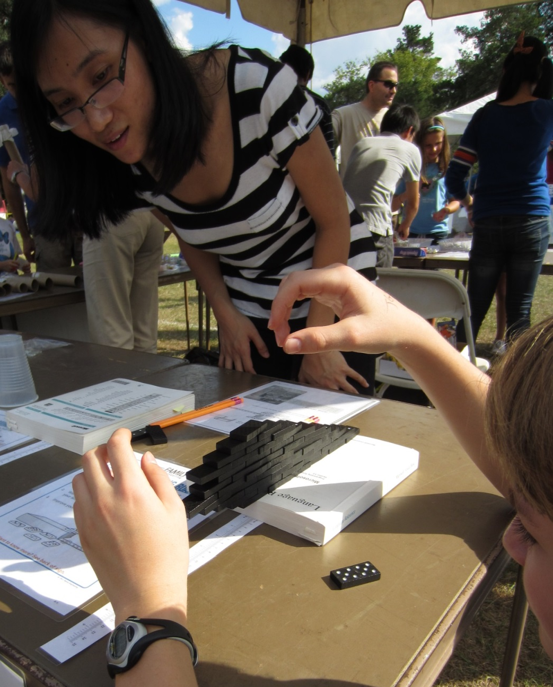


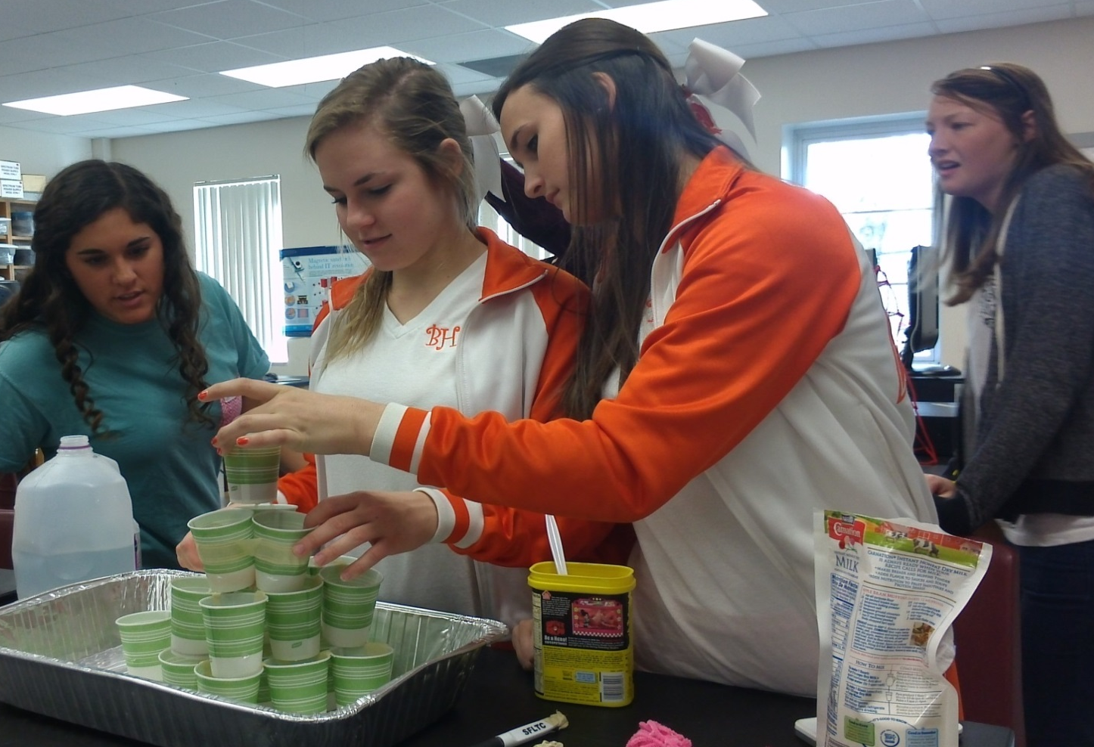
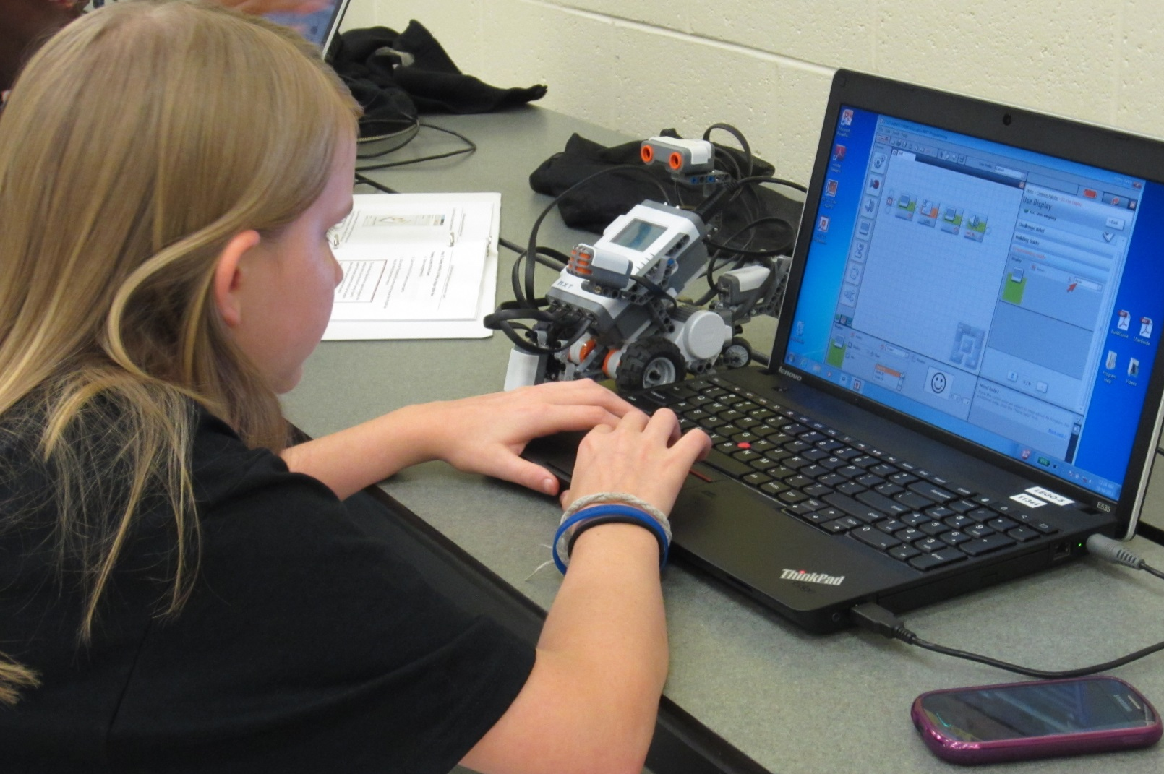
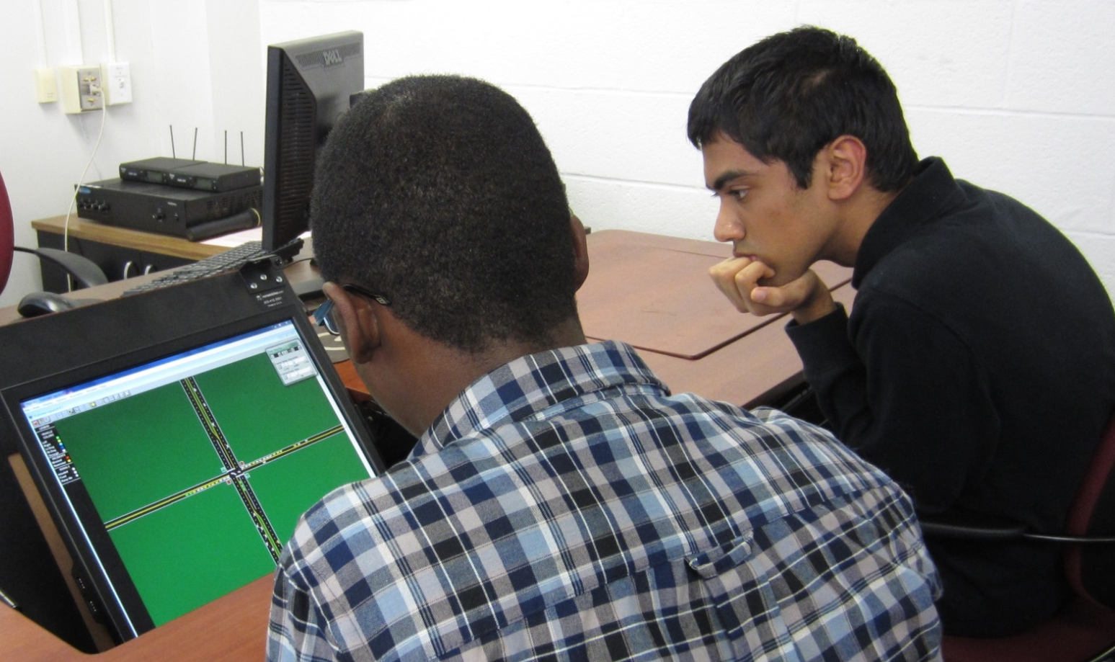
K-12 Transportation Workforce Development:
A Collaborative Effort
In order to ensure that young people are attracted to the transportation jobs of the future, STRIDE is working to develop local, state, and national partnerships throughout the transportation and education communities while collaborating on outreach programs within the southeast region consortium. A sample of activities follows.
1. Designing a cantilever
1. Family Engineering Night
MSU, UAB, FIU and UF hosted Family Engineering Nights at local elementary schools. Family Engineering Night is an informal engineering education program that engages elementary-age children and their families in fun, hands-on, engineering activities.
2. Engineers Change the World – A Hands-on Workshop for GIRLS 13-18 Years Old
NCSU and UF have collaborated with the North Carolina Department of Transportation (NCDOT) and the Women’s Transportation Seminar (WTS) for this project, which includes a series of one-day workshops targeted at girls in high school. Speakers, role models, mentors, and experimental, hands-on activities serve to engage and inspire.
3. LEGO® Robot Vehicle Lesson Plans
NCSU, UF, and FIU offered LEGO® Robot Vehicle Lesson Plans for Secondary Education. The “Introduction to Transportation Engineering” curriculum, developed at UF, is offered to students in grades 5-8. The lessons contain the fundamentals of transportation engineering, which teach students how advanced technology is integral to solving transportation problems.
2. Testing gravity with hot chocolate machine
4. Transportation Career Day
A Transportation Career Day was held at UF and FIU to introduce transportation to high school students. The day included a presentation, a signal lab tour and a hands-on traffic simulation exercise.
3. Programming a robot to detect a pedestrian
4. Traffic simulation exercise

