Slide 1
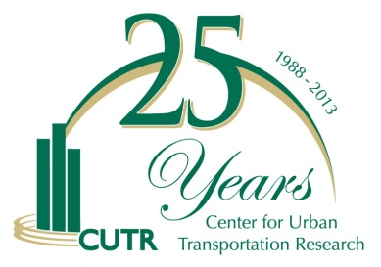
Maintaining Transit Effectiveness Under Major Fiscal Constraints
November 14, 2013
Joel Volinski, NCTR Director

Slide 2
Study Sponsor and Objective
Funded through TCRP Synthesis Program (SA-30)
Due to be published by Spring of 2014
Identify actions transit agencies have taken to maintain effectiveness during the Great Recession
“Effectiveness” means providing as much quality service as possible in keeping with community values while normal sources of revenues were reduced
Identify cost savings and revenue generation techniques and processes to work with employees and the public during difficult times
Notes:
Had a project panel and managed by Donna Vlasak. I thank the panel, TCRP staff, and the agencies that completed a tough survey. – No off the shelf definition of “effectiveness”. Had 40 different answers, but usually include efficient, productive, socially aware, quality, customer sensitive, community goals

Slide 3
Methodology
Survey sent to 46 transit agencies of all sizes throughout the country
Extensive literature search including recent articles in newspapers and industry magazines
Considerable information collected from personal emails with transit managers
Notes:
I have done similar research through NCTR over the past 17 years

Slide 4
Results of Surveys/Literature Search
Survey responses received from 40 agencies (87% response rate)
Emails from over 40 other transit managers
Dozens of newspaper and magazine articles
Over 200 techniques were reported from 100 different agencies

Slide 5
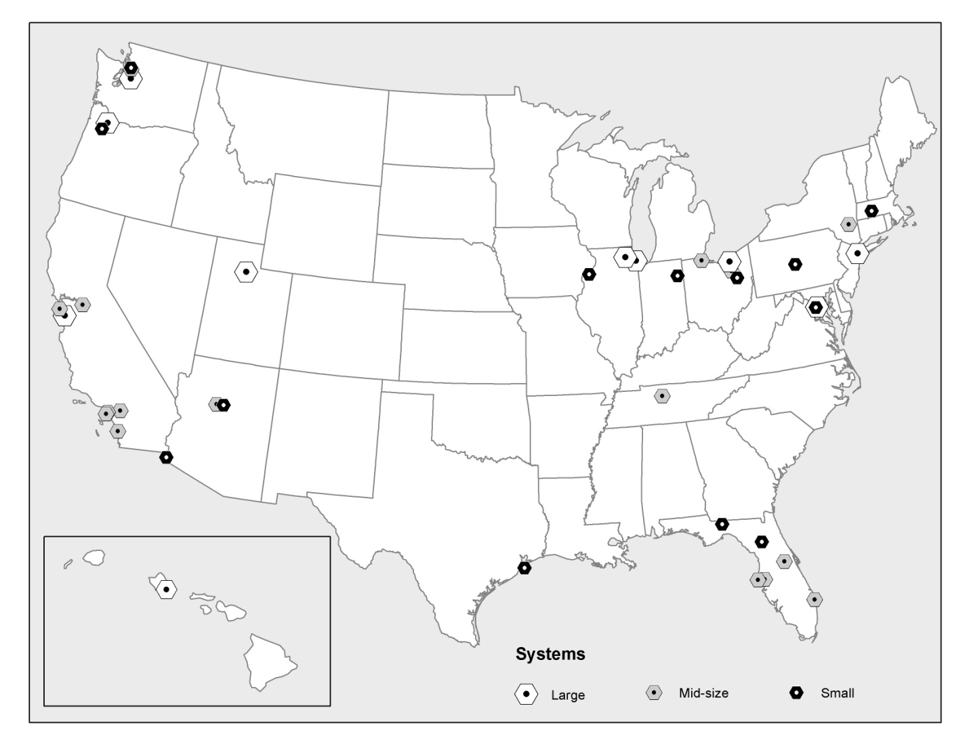
Respondents to the Project Survey
Notes:
Agencies from 17 different states and most regions

Slide 6
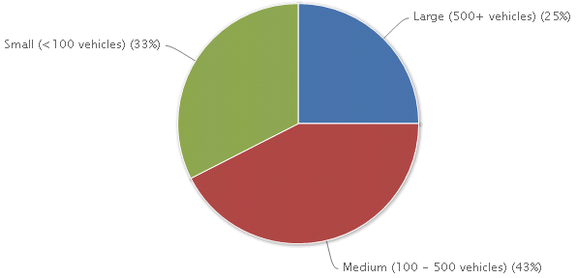
Size of Responding Transit Agencies
Notes:
10 large systems, 17 mid-size systems, and 13 small systems responded to the survey

Slide 7
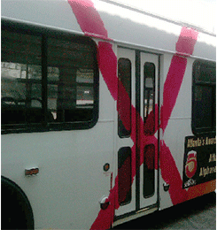
Painful Recession-Driven Choices
Layoffs
Hiring Freezes
Wage Freezes
Furloughs
Elimination of Vacancies
Reduced training and professional development
Deferred Maintenance/Reduced Capital

Slide 8
Impacts on Customers
84% of agencies reported they considered raising fares or cutting service
59% already had done so by April 2010
“MARTA to slash a quarter of service”
“MTA to eliminate 1,000 positions”
“Riders to feel steep CTA cuts Monday”
“End of the line for PDRTA?”
“Community Transit cut service 29%”

Slide 9
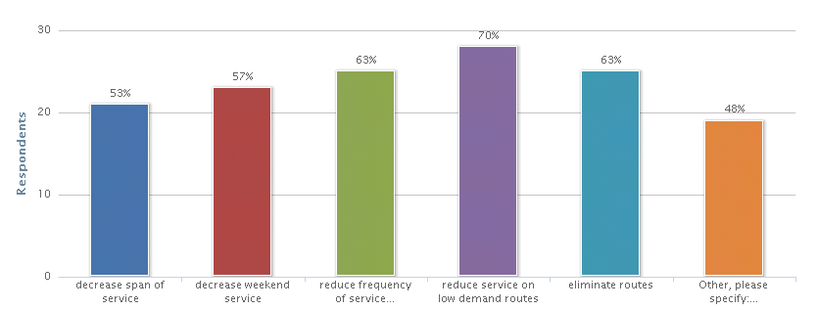
Responding agencies service reductions by type between 2008 and 2012
Notes:
“Other actions included eliminating Sunday service, reducing night service, or combining routes

Slide 10
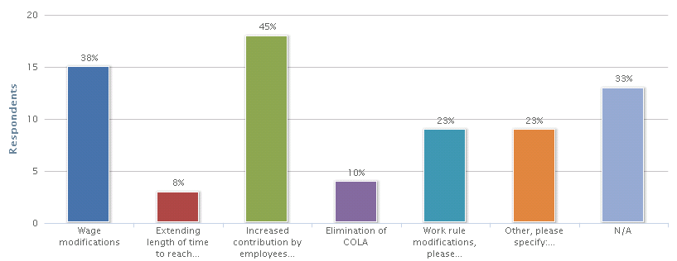
Impact on Employees
Notes:
Primary method of savings was through higher contributions (cost sharing) by employees for health care benefits. Incentives played a very minor role. Overtime starts only after 40 hours for a week, not for more than 8 hours in a day. Straight runs requirement was reduced. Some pension plan changes.

Slide 11
Impact on Employees
Agencies reported eliminating up to 30% of administrative positions, consolidating functions, restructuring, broadening jobs
A deep sense of grieving during the layoff period and thereafter, increased levels of stress, lowered morale, risk avoidance, and withdrawal.
“There is a limit to how much smarter you can work”
“Outsourcing administrative work comes with reduced quality of service”
“We had to give managers permission to do less”
Open communication on changes is the best approach
Survivor’s guilt

Slide 12
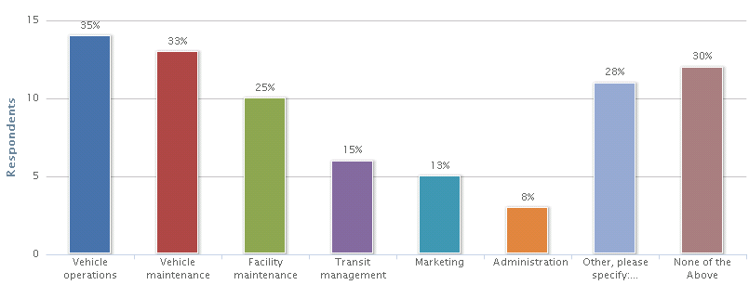
Outsourcing different functions
Notes:
Paratransit, Inventory management, FMLA Administration, Law enforcement, rail vehicle cleaning. Numerous objective studies have shown a substantial savings (on average 20%) when bus operations are contracted out. NCSD is best example of significant savings.

Slide 13
Consequences of Fiscal Constraints
In spite of a majority (59 percent) of responding transit agencies providing fewer total service hours in FY 2012 than in FY 2008, the majority of agencies (62 percent and 60 percent) carried more passengers per hour and more total passengers in FY 2012 than in FY 2008.
Transit agencies are becoming more efficient, partially due to necessity, but also due to better management

Slide 14
Managing Resources is Critical
Creativity/desperation is still alive and well.
The structural problem was/is huge, and these techniques might not bridge all budget gaps, but agencies can still help themselves.
Some actions were significant and others minor, but all are evidence of systems that are doing everything possible to avoid cutting service or asking for more tax support
Notes:
Necessity is the mother of invention. Never waste a good crisis

Slide 15
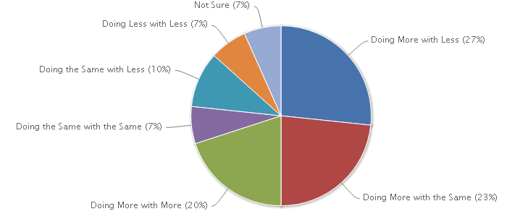
How agencies felt they were doing comparing 2012 to 2008

Slide 16


More Data-Driven Management
GCRTA’s TransitStat program, CTA’s Performance Measurement Program, UTA’s ISO 14001 process, SCRTA’s Key Performance Indicators, Nashville MTA’s Results Matters program, San Joaquin’s TransTrack, MDT’s Six Sigma process
All provide business intelligence solutions that transforms volumes of data into meaningful information for managers to use in developing immediate actions, strategies, and plans to ensure optimal operations and performance
American Bus Benchmarking Group
Notes:
Different agencies use different processes, but all are designed to provide accurate measurements of performance in a more results-oriented environment. – ABBG has 18 members at the moment, but is expected to grow and allows peer comparisons among transit agencies to encourage even better performance

Slide 17
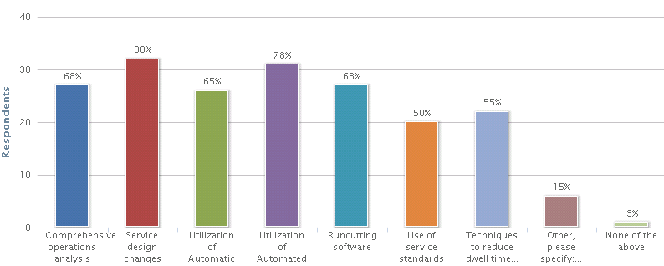
More efficient bus operations
Notes:
In most cases money wasn’t necessarily saved, but resources were reallocated to more productive routes and services resulting in increased ridership and productivity. All of this was made possible by better software for ridership analysis that allows changes to be made with almost surgical precision. Numerous agencies reported reducing service hours by 5% or more with virtually no loss of ridership, and in many cases increases in ridership. Better service standards were adhered to with great results. AVL information provides information that is absolutely craved by passengers. Better scheduling software resulted in reduced overtime.

Slide 18
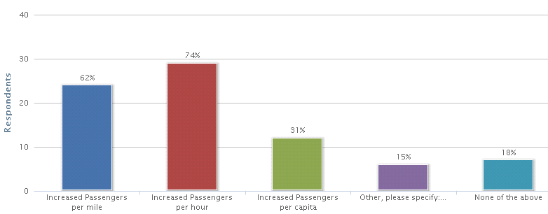
Achieved service efficiencies by category
Notes:
In the “Other” category, respondents noted efficiencies in the form of on-time performance and decreased costs per passenger.

Slide 19
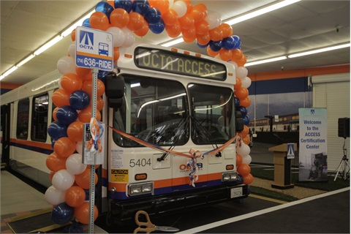
Savings in Paratransit
In-house assessment allow accurate determination of passengers’ capabilities to use fixed route service
Passengers are either going to be eligible for paratransit services, get a half-price fare card, or participate in travel training and become fixed-route users

Slide 20

Savings in Paratransit
Switching from Cutaways to Minivans or hybrid vehicles (or propane vehicles) to save substantially on fuel
Using taxis for short trips, hard-to-route trips, or for unusually high peak demand
Using 15-minute video to show at assisted living centers to educate passengers to fixed route alternatives
Partnering with local non-profit agencies to provide trips
Scheduling software and mobile data terminals increase productivity
IVR reduces no-shows and dwell time
Notes:
Toledo noted a 25% increase in productivity from scheduling software. Mobile data terminals have also improved efficiency

Slide 21
Maintenance efficiencies
Electrification of bus components such as air conditioning, engine cooling, power steering to reduce parasitic load and save as much as 15% on fuel
Conversion of fleets to CNG
Bringing light rail maintenance in house saved $1.6 M
Contracting out bus maintenance saved $250,000 at NCTD
Using 3rd party vendors to handle inventory
Use of software to monitor preventive maintenance and fluid consumption
Using developmentally disabled to clean buses

Slide 22
Savings from Greener Facilities
SEPTA saved $100,000 (12%) a year in utility costs at headquarters by:
  Cleaning offices during the day
  Installing motion detection light switches
  Installing more energy efficient AC and boilers
  Less energy-hoggish elevators and escalators
  Installing LED lighting wherever possible
  Installing film on south-facing windows
  Considering wind power capture on roof of headquarters
Installing a wayside energy storage device at substations along rail tracks that will Save $190,000 a year and allow them to sell excess energy

Slide 23
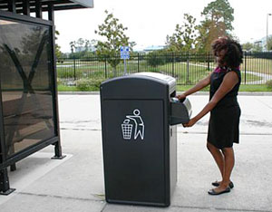
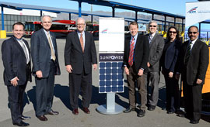
Efficiencies in utilities
Base Interruptible Programs are used at Connecticut Transit and Long Beach Transit to reduce electricity rates
Solar trash compactors are used at PSTA with sensors that communicate when trash needs to be removed
VTA installed solar panel canopy systems to park buses under for shade, savings on future energy costs, and reduced footprint

Slide 24

Controlling Health Care Costs and Workers Compensation
HART decided to self-insure and pay for claims less than $100,000 after paying $5.4 million more in premiums than the claims totaled over 5 years
Higher co-pays, but premium differential is offered based on participation in wellness programs
Contract for Third Party Administrators to handle Workers Comp claims and FLMA
Alternative work assignments (Light duty) reduced time away from work from 91 to 47 days at WMATA

Slide 25

Efficiencies through Technology
AVL and signal priority have improved scheduling and on-time performance and customer satisfaction and reduced need for street supervision
APCs have allowed reductions in hours, identified bus stops for elimination, and reduced required surveying
Audible pedestrian warning system has reduced claims
Scheduling software for paratransit and fixed route
Enterprise Resource Planning platforms enable efficiencies in HR, Finance, Accounting
Security cameras have led to many arrests and lower claims
Notes:
Scheduling software reduces deadhead miles and overtime, increases straight runs. It saved $12 million at King County Transit

Slide 26

Efficiencies through Technology
Multimodal trip planners and Interactive Voice Response systems have allowed reductions in customer service staff
SJRTD developed “Text Bus” to provide real time information on demand for each bus stop
Virtualization technology reduces number of needed servers and reduce power consumption and AC
Installation of Wi-Fi on express buses increased ridership by 8% in San Jose
Social media improves customer information, reduces cost of printed materials, and permits 2-way communications
Notes:
Virtualization has saved Long Beach Transit $200,000 a year.

Slide 27
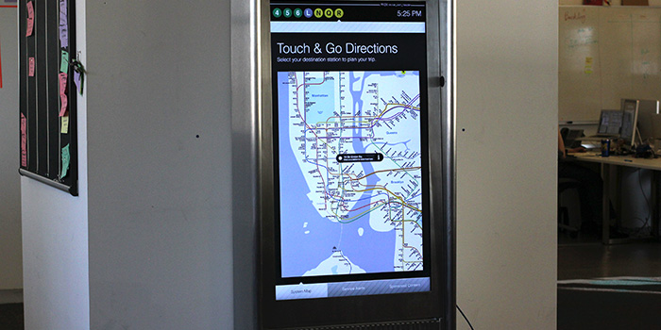
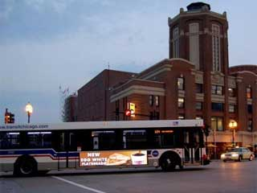
Marketing and Advertising
Digital advertising is now on buses, at kiosks, stations, and billboards on transit properties (will bring CTA $3.3 million a year)
Ads are also on farecards, system maps, websites, bus floors, etc.
Notes:
This amount represents the value of time lost during weekdays between 9 AM and 4:30 PM under current conditions. It does not include potential effects of developments that are currently under construction or future developments. In addition, the study reflects the conditions experienced during the two-day fieldwork, which may differ in a different week or month.

Slide 28
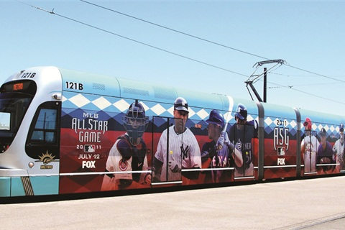
Marketing and Advertising
Denver now wraps light rail trains and is scheduled to receive over $1.6 million annually
Audio advertising is now in place in over a dozen small and mid-size transit agencies
Ads for alcohol are now more common in major cities ($1.2 million for CTA)

Slide 29
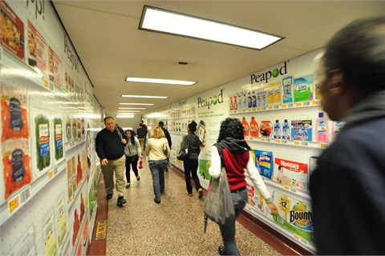
Partnering in Marketing
CTA has partnered with Groupon to sell three-day passes to visitors from around the world
Online grocery store Peapod.com provides virtual grocery aisles at train stations and delivers selected products to passengers’ homes

Slide 30
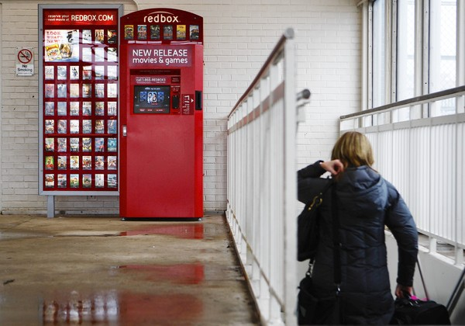
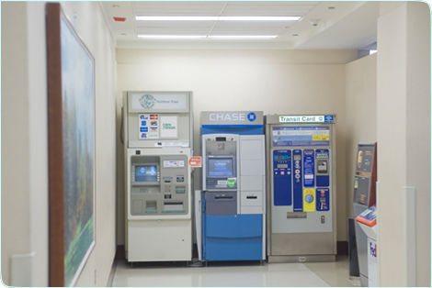
Partnering in Marketing
Redbox video kiosks are in place at CTA stations for ease of acquiring low cost video rentals
Financial institutions are paying over $1 million per year for ATMs at transit stations in Chicago

Slide 31
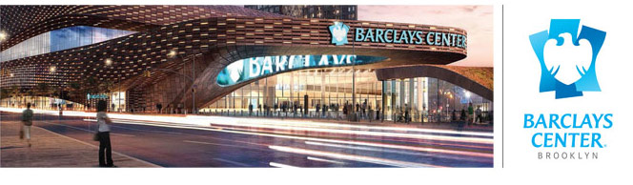
Sale of Naming Rights
Barclays has paid $4 million to name a new train station in Brooklyn, SEPTA realized $3 million from AT&T, and Chicago received $3.9 million from Apple
TriMet sells naming rights to streetcar stops for $500 a month and the streetcars themselves for $25,000 a year

Slide 32
Revenues from Facilities
SEPTA leased empty office space to earn over $7 million
MBTA securitized parking facilities (50,000 spaces) by selling bonds secured by future parking revenues to receive a lump sum payment and pay off long term debt
MDT leases property under its elevated heavy rail system to adjacent property owners for additional parking

Slide 33
Greater Use of Public Partners
Military bases
Universities
Public schools
Transportation Management Associations
Downtown Development Authorities
Convention centers
Social service agencies
Municipalities

Slide 34
Greater Use of Private Partners
Shopping malls
Business parks
Museums
Hotels
Major employers and business associations
Hospitals
Casinos
Notes:
Some agencies such as JTA and RGRTA have a person known as “Business Development” to actively find new partners

Slide 35
New Sources of Operating Revenue
Marin County passed a $10 increase in vehicle registration fees generating $2 M for transportation: transit gets 35%
Corvallis passed a Transportation Utility Fee to replace ad valorem tax and remove transit from general fund
Rhode Island passed a two-cent gas tax with all proceeds ($9M) going to transit (RIPTA)
Sales taxes on internet purchases passed by Virginia and Maryland to enhance and/or replace gas taxes
Surcharges on tickets to major events
Notes:
Sierra Club and Save the Bay environmental groups were key advocates in Rhode Island. Constitutionality of these Internet taxes might be challenged. California is looking at event surcharges and could raise tens of millions.

Slide 36
Contact
Joel Volinski, Director
National Center for Transit Research
University of South Florida
volinski@cutr.usf.edu
813.974.9847

