Slide 1
Analysis of Heavy Vehicle Effects on Florida Freeways and Multilane Highways using an Advanced Vehicle Performance Modeling Approach by Seckin Ozkul

Slide 2
Outline
Background
Problem Statement
Research Objectives
Methodology
PCE Results
Conclusion

Slide 3
Background Commercial Truck Performance
HCM is considered as the primary guide for conducting highway capacity and level-of-service (LOS) analyses in the US.
An important measure for the traffic stream is hourly demand volume (veh/h or veh/h/ln).
Capacity is defined in pc/h/ln.
Passenger car equivalency (PCE) values being the conversion factor from veh/h/ln to pc/h/ln.
HCM 2010 PCE values are based on a study done on mid/late-1990’s (Webster and Elefteriadou).
Notes:
An important measure for the traffic stream is hourly demand volume (veh/h or veh/h/ln).
Per this hourly demand volume, it can be determined if the roadway is operating below (under-saturated flow) or above (over-saturated flow) capacity (max: 2400 pc/h/ln).

Slide 4
Problem Statement Commercial Truck Performance
Webster and Elefteriadou study PCEs were based strictly on simulation and CORSIM (5.0).
CORSIM 5.0 and 6.3, VISSIM, AIMSUN, and Paramics all utilize a maximum acceleration versus speed table (simplistic, look-up table).
Max. accel. & grade adjustment factor values (convoluted relationship).
Difficult to ensure the effect of grade on maximum acceleration is properly accounted for.

Slide 5
Problem Statement (cont’d) Commercial Truck Performance
Transmission gear changing capabilities of commercial trucks are not accounted for.
Combined, these assumptions and shortcomings of the traffic simulation tools result in:
Overestimated vehicle deceleration
Overestimated PCE values in the HCM 2010
Underestimated traffic stream speeds
Underestimated capacity values

Slide 6
Research Objectives Commercial Truck Performance
Development of an advanced/full vehicle dynamics modeling approach.
Determination of accurate PCE estimation equations.
Notes:
- that is integrated into traffic microsimulation (no peak power assumption and capability of transmission gear changing).
- based on a traffic microsimulation tool that uses the full vehicle dynamics modeling approach developed.
-

Slide 7
Methodology Commercial Truck Performance
Commercial Truck Classification and AADT Data
24 Active Permanent Weigh-in-Motion (WIM) Stations located on Florida freeways and highways (2008 through part of 2011).
FDOT’s Statistics Office provided a DVD that contains FDOT Traffic information such as AADT and total commercial truck volume per class.

Slide 8
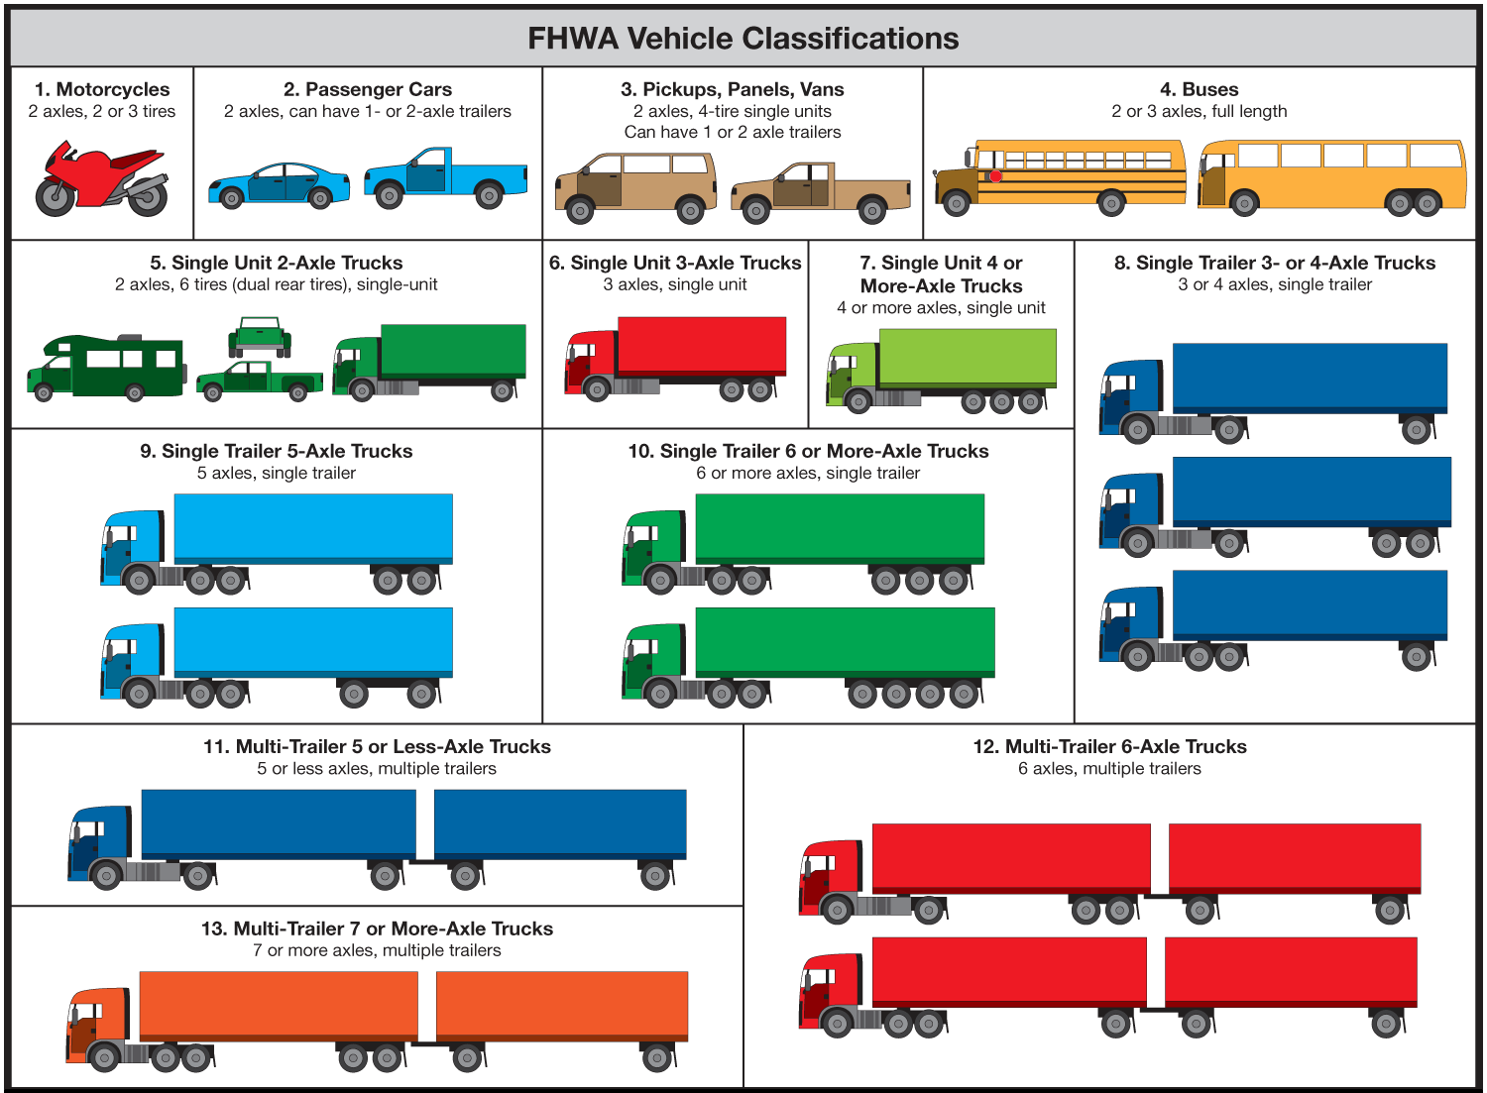
Methodology Commercial Truck Performance
Figure 1-1. FHWA Vehicle Classification
Source: www.onlinemanuals.txdot.gov/txdotmanuals/tri/images/FHWA_Classification_Chart_FINAL.png. – Last accessed on April 26, 2013.

Slide 9
Methodology Commercial Truck Performance
Determination of Current Truck Fleet
Table 1-1. Overall Truck Classification History as % of Truck AADT
Truck Class | Total Volume Per Truck Class | % of AADT
5 | 26326 | 25.36%
6 | 6354 | 6.12%
7 | 1092 | 1.05%
8 | 10456 | 10.07%
9 | 55446 | 53.41%
10 | 605 | 0.59%
11 | 2159 | 2.08%
12 | 1100 | 1.06%
13 | 275 | 0.26%
TOTAL % |  | 100.00%

Slide 10
Methodology Commercial Truck Performance
Determination of Current Truck Fleet (cont’d)
From the data – four prevalent commercial trucks (accounting for more than 98 percent of the commercial truck fleet in Florida).
Single Unit (SU) Trucks: Classes 5 and 6
Intermediate Semitrailer: Class 8
Interstate Semitrailer: Class 9
Semi-tractor+Double-trailer: Classes 11 and 12

Slide 11
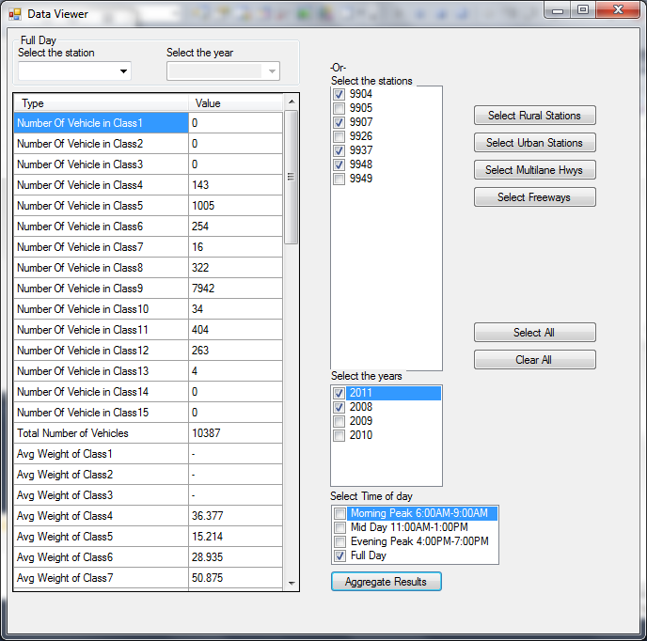
Methodology Commercial Truck Performance
Commercial Truck Characteristics Data
Average weight
Average length
Average speed
Figure 1-2. Custom Data Analysis Program Control Window

Slide 12
Methodology Commercial Truck Performance
Custom Traffic Simulation Platform
At UFTI, CORSIM is typically the simulation tool used (maintained at UF and full access to the source code).
However, as mentioned before CORSIM 6.3:
Simplistic method of determining max. commercial truck accel.
Max. accel. values and the grade adjustment factor relationship is convoluted.
Software architecture of the current version of CORSIM is also not amenable to implementing a more comprehensive and accurate vehicle maximum acceleration modeling approach.

Slide 13
Methodology Commercial Truck Performance
Custom Traffic Simulation Platform (cont’d)
Therefore, a custom traffic microsimulation tool that employs state of the art software architecture is utilized for this study.
Built on the C# / .NET framework programming model
Object oriented architecture
Most of the vehicle movement logic is the same as employed in CORSIM 6.3, with some exceptions:
Custom simulator uses the Modified Pitt car following model, not Pitt.
Discretionary lane changing biases slowest vehicles to outer most lane.

Slide 14
Methodology Commercial Truck Performance
Custom Traffic Simulation Platform (cont’d)
Vehicle data integrated into the custom traffic simulation tool
Table 1-2. Vehicle Characteristics Data
 | Passenger Car | Single Unit Truck | Intermediate Semi-Trailer | Interstate Semi-Trailer | Semi-tractor+double-trailer
Vehicle Height (ft) | 4.46 | 10.00 | 10.00 | 10.00 | 10.00
Vehicle Width (ft) | 5.74 | 7.00 | 8.00 | 8.00 | 8.00
Vehicle Length (ft) | 16.00 | 29.00 | 55.00 | 68.50 | 74.60
Vehicle Weight (lb) | 3060 | 25,000 | 37,000 | 53,000 | 55,000
Maximum Torque (lb-ft) | 139 | 660 | 1650 | 1650 | 1650
Maximum Power (hp) | 197 | 300 | 485 | 485 | 485
Wheel Radius (ft) | 1.03 | 1.66 | 1.66 | 1.66 | 1.66
Differential Gear Ratio | 4.77 | 4.40 | 3.50 | 3.50 | 3.50
Transmission Gear Ratios
Gear 1 | 3.27 | 7.59 | 11.06 | 11.06 | 11.06
Gear 2 | 2.13 | 5.06 | 8.20 | 8.20 | 8.20
Gear 3 | 1.52 | 3.38 | 6.06 | 6.06 | 6.06
Gear 4 | 1.15 | 2.25 | 4.49 | 4.49 | 4.49
Gear 5 | 0.92 | 1.50 | 3.32 | 3.32 | 3.32
Gear 6 | 0.66 | 1.00 | 2.46 | 2.46 | 2.46
Gear 7 | N/A | 0.75 | 1.82 | 1.82 | 1.82
Gear 8 | N/A | N/A | 1.35 | 1.35 | 1.35
Gear 9 | N/A | N/A | 1.00 | 1.00 | 1.00
Gear 10 | N/A | N/A | 0.74 | 0.74 | 0.74

Slide 15
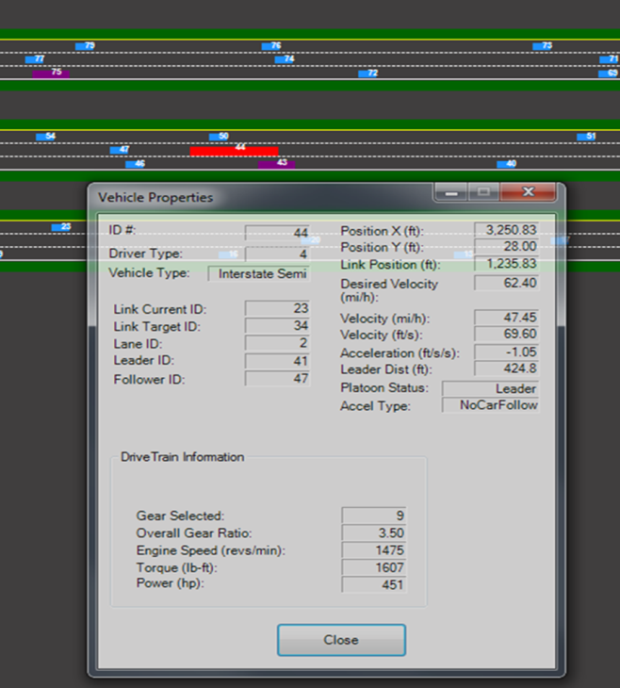
Methodology Commercial Truck Performance
Figure 1-3. Custom Traffic Simulation Program Animation Window

Slide 16
Methodology Commercial Truck Performance
TruckSim
As a validation tool, TruckSim was chosen since:
TruckSim provides detailed simulation of individual commercial trucks (not a traffic microsimulation tool).
Is based on mathematical models of the commercial truck’s:
powertrain (engine, transmission)
physical characteristics

Slide 17
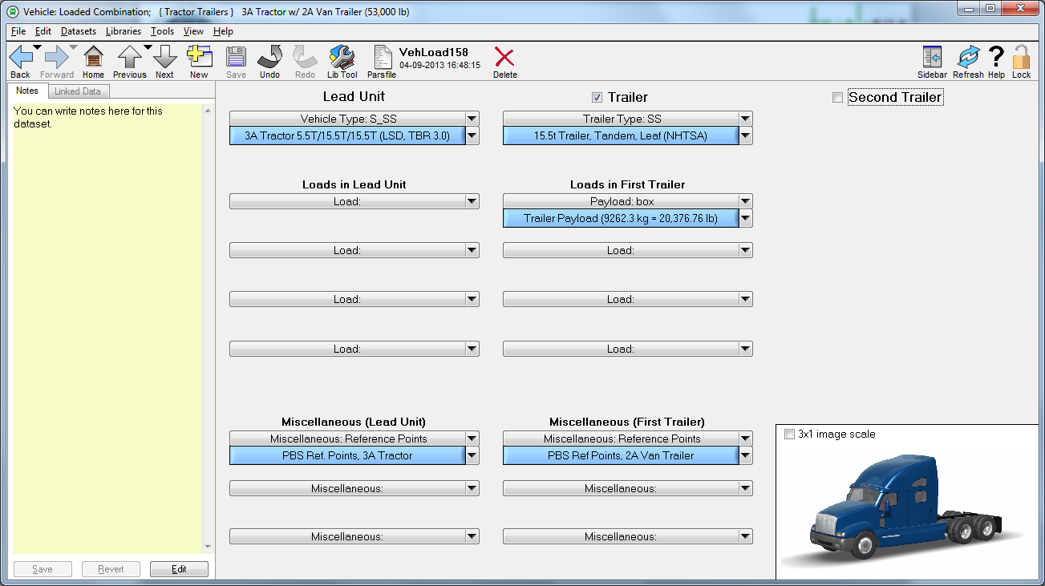
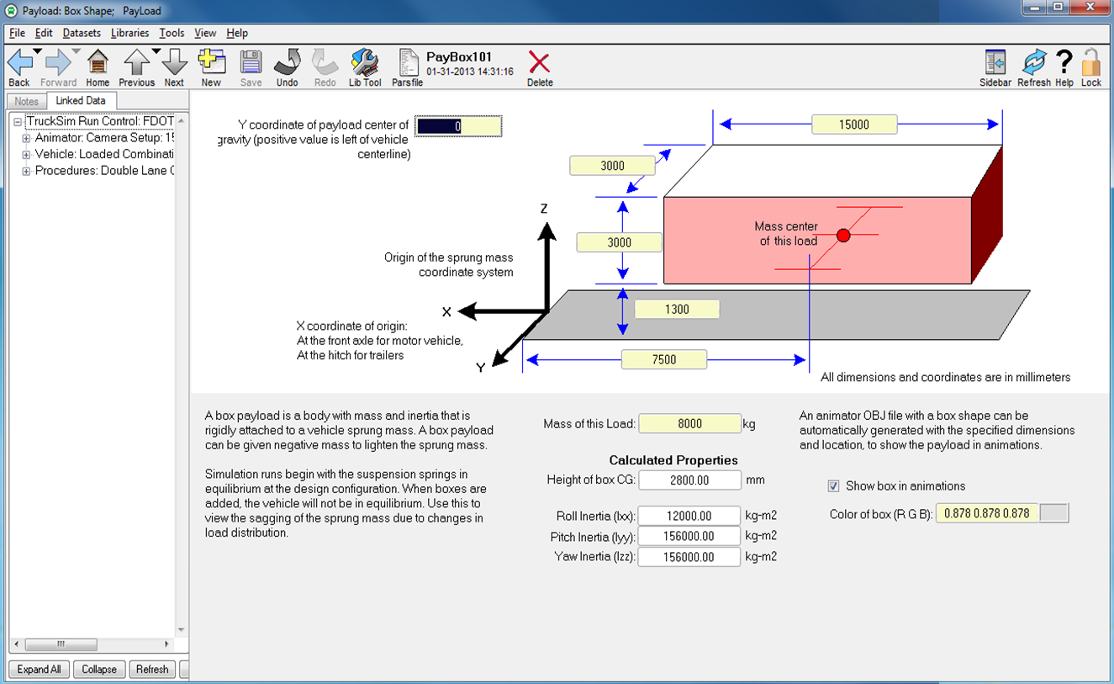
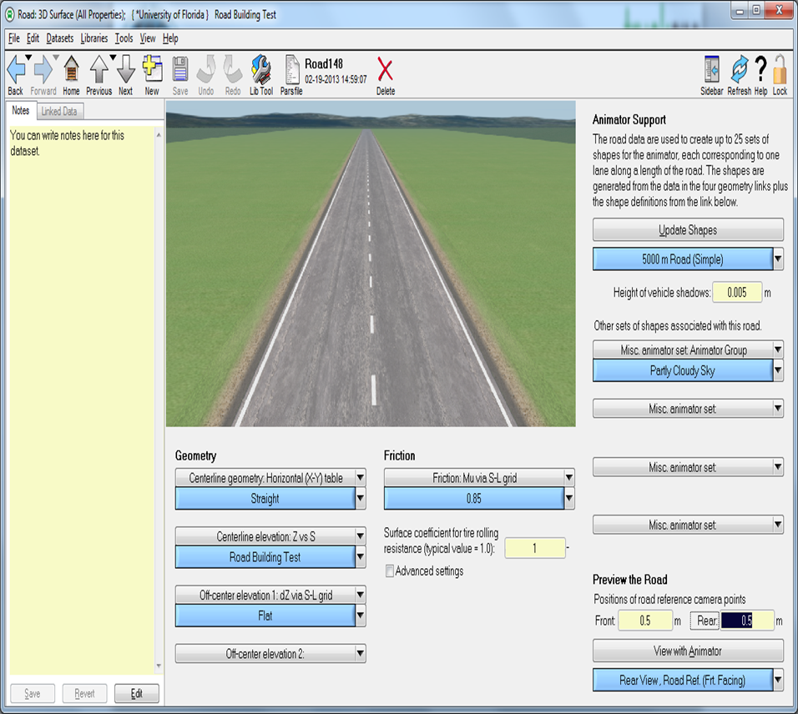
Methodology Commercial Truck Performance
TruckSim (cont’d)
Figures 1-4 & 1-6. TruckSim Vehicle Attributes and Roadway Geometry Windows

Slide 18
Methodology Commercial Truck Performance
Advanced/Full Vehicle Dynamics Approach
The need to develop a full vehicle dynamics modeling approach was realized through existing methodology results comparisons.
The approach at the most basic level has the equation.
$F=m×a+R_{a}+R_{rl}+R_{g}$ (Eq. 3-1)
Tractive effort ($F$) is the lesser of:
Maximum tractive effort (the amount of force that can be accommodated by the tire-pavement interface)
Engine-generated tractive effort (function of engine torque, transmission and differential gearing, drive wheel radius)
Available tractive effort (minimum of the two)
For vehicles with low power-to-weight ratios (commercial trucks), engine generated tractive effort governs.

Slide 19
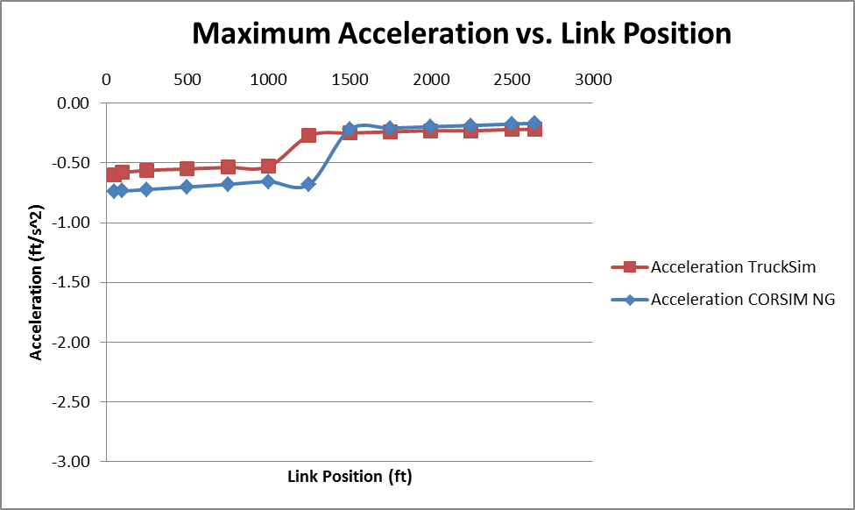
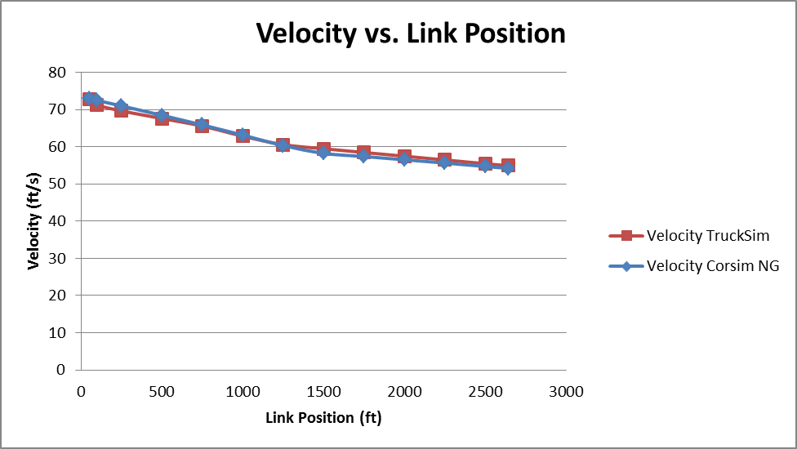
Methodology Commercial Truck Performance
Advanced/Full Vehicle Dynamics Approach (cont’d)
Figure 1-9. Transmission Gear Change Capable Maximum Acceleration of an Interstate Semi-trailer on a 2640-foot Link with 6% Grade
Figure 1-10. Transmission Gear Change Capable Velocity of an Interstate Semi-trailer on a 2640-foot Link with 6% Grade

Slide 20
Methodology Commercial Truck Performance
Experimental Design
Table 1-3. Variables used for Experimental Design in Simulation Runs
Variable | Setting Level
Number of lanes in analysis direction | 2-lanes
 | 3-lanes
Roadway Grade | Level
 | 3%
 | 6%
Free-Flow-Speed (mi/h) | 55
 | 65
 | 75
Segment Length (ft) | 1320
 | 2640
 | 3960
 | 5280
HV Percentage | 5%
 | 10%
 | 15%
 | 20%

Slide 21
PCE Results Commercial Truck Performance
PCE Estimation Equations
Class 8 and Class 9 truck operations were found to be similar due to:
Drivetrain and physical characteristics being very similar.
3 classes of trucks were used as the final reporting categories:
Single Unit (Small)
Semi-tractor+trailer (Medium)
Semi-tractor+double-trailer (Large)

Slide 22
PCE Results Commercial Truck Performance
PCE Estimation Equations (cont’d)
$${PCE}_{ST}=0.966+0.0000154×{\left(Min\left(SegLen ×Prop. Grade, 300\right)\right)}^{2}−0.000101×\left(Min\left(SegLen×Prop. Grade, 300\right)\right)+0.0037 ×Max\left(FFS,66\right)−0.0801×NumLanes+1.21×Prop. Small Trucks+0.0031×Max\left(Flow Rate, 100\right)×Prop. Small Trucks$$
$${PCE}_{MT}=1.095+0.0000165×{(Min(SegLen ×Prop. Grade, 300))}^{2}−0.000105×(Min(SegLen×Prop. Grade, 300))+0.00255×Max(FFS,66)−0.07774×NumLanes+2.148×Prop. Medium Trucks+0.00244×Max(Flow Rate, 100)×Prop. Medium Trucks$$
$${PCE}_{LT}=1.246+0.0000171×{(Min(SegLen ×Prop. Grade, 300))}^{2}−0.0000335×(Min(SegLen×Prop. Grade, 300))+0.00264×Max(FFS,66)−0.10316×NumLanes+1.98×Prop. Large Trucks+0.00401×Max(Flow Rate, 100)×Prop. Large Trucks$$

Slide 23
Conclusions
The new advanced vehicle dynamics modeling approach ensures that that the deceleration on grades is not overestimated by accounting for gear changes.
Even though it is difficult to compare the PCE values obtained in this study to the HCM PCE values , as expected, they were generally lower.

Slide 24
Questions/Comments

