Slide 1


Evaluating Safety Performance of Bridges on Major Highways in Alabama
Jing Li, Post-doc Researcher
Gaurav Mehta, PhD Candidate
Steven Jones, Associate Professor
Department of Civil, Construction and Environmental Engineering
The University of Alabama, Tuscaloosa, Alabama
2014 UTC Conference for the Southeastern Region
March 25th, 2014

Slide 2

Outline
Background
Data Description
Modeling Methodology
Modeling Results
Conclusion

Slide 3

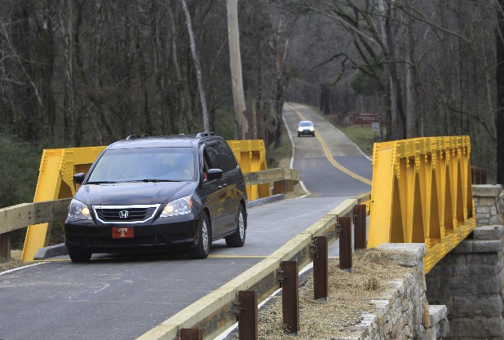
Background
Bridges are integral infrastructure components that are usually the subject of structural performance research.
How bridges affect traffic safety when serving as parts of road facilities?
Bridge in Tuscaloosa
Photograph by William Woodward from http://www.wheretowillie.com.
Photo by Dan Henry from http://www.timesfreepress.com.

Slide 4
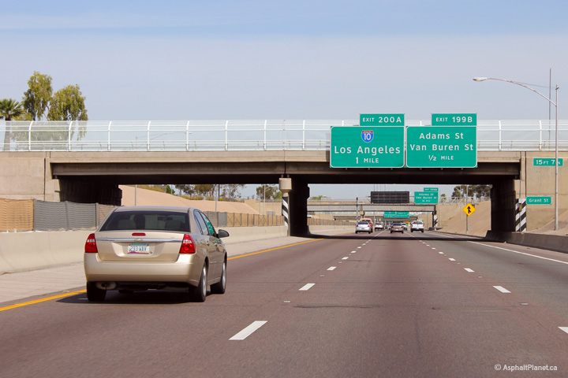

Background
Railings that keep vehicles from running off the road
Piers as fixed objects may pose hazards to traffic safety
Abutments that may constitute a roadside safety hazard
Photograph from http://www.asphaltplanet.ca/AZ/I/17/
In this study, we focus on traffic safety ON bridges…
Photograph by disneymike on Flickr

Slide 5
Background
Objective of Study
Develop safety performance functions (SPFs) for crashes occurring on bridges.
Understand how bridge characteristics affect crash occurrences.
Applications in practice
Estimating the expected number of crashes on bridges.
Help transportation officials in prioritizing safety-related projects.

Slide 6
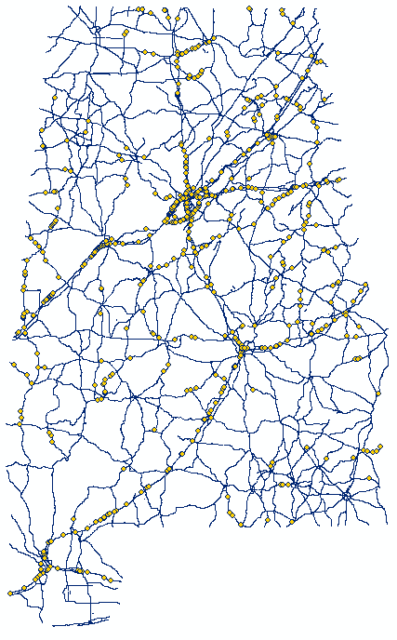
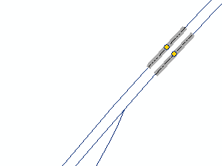
Data Description
Bridges of interests: Alabama highway bridges
      Bridges in Alabama
      Bridges carrying state or interstate highways
      NBI (National Bridge Inventory) database
      Alabama DOT bridge inventory database
      1,122 bridges in the final list for this study
      Additional efforts needed:
      Original bridge points
        Bridge vectors

Slide 7
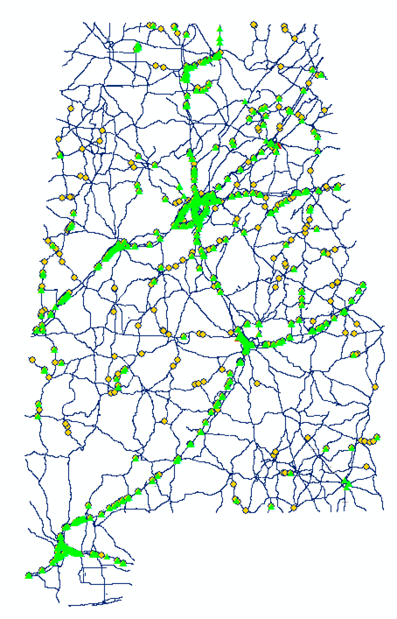
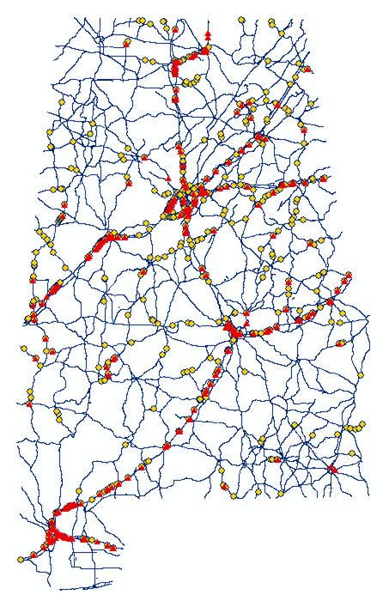
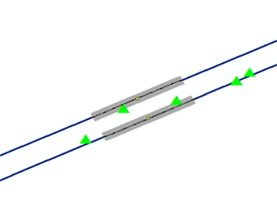
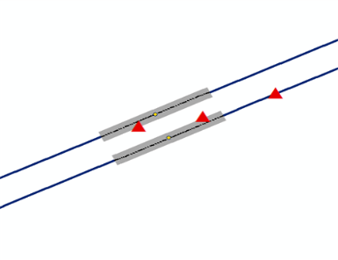
Data Description
Crashes of interests: crashes occurred on the 1,122 Alabama highway bridges
      Associate crashes with bridges
      9,958 overall bridge crashes
      (2009-2012)
      865 single vehicle bridge-rail related crashes (2010-2012)

Slide 8
Modeling Methodology
Data Analysis
Crashes are rare and random events
Discrete count models
Observed crash counts as over-dispersed data
Negative Binomial model (NB2 formulation)
Best Model Identification (goodness of fit)
Log-likelihood value
Akaike information Criterion (AIC)
Model Validation
Validation date set
Model validity measures

Slide 9
Modeling Results
      Crash data set
        Training set
        Validation set
        NLOGIT4.0
        Candidate Negative Binomial regression models
        (NB2 formulation)
        Validity measures
        Log-likelihood value
        &
        AIC
        Potential best model(s)
        Best model

Slide 10
Modeling Results
SPF for overall vehicle crashes
Variables | Best model | Comparable model
Intercept | -9.1586 (0.2541) | -8.902 (0.2106)
AADT | 0.9564 (0.0297) | 0.9713 (0.0228)
Bridge Length | 0.3562 (0.0191) | 0.9768 (0.1769)
Transition | -0.5630 (0.1646) | -
Approach | 0.2020 (0.0869) | -
Railing | 0.2894 (0.1691) | -
Percentage Truck | -0.0209 (0.0048) | -0.0222 (0.0042)
Shoulder Width | 0.4251 (0.0904) | -
Dispersion Parameter | 4.476 | 4.6364
Log-Likelihood | -3243.97 | -3264.23
AIC | 2.6034 | 2.6164

Slide 11
Modeling Results
SPF for single vehicle bridge rail-related crashes
Variables | Best model
Intercept | -4.8136 (0.8541)
AADT | 0.2490 (0.0897)
Bridge Length | 1.0918 (0.2930)
Transition | -
Approach | -
Railing | -
Percentage Truck | 0.0322 (0.0080)
Shoulder Width | -
Dispersion Parameter | 8.412
Log-Likelihood | -941.40
AIC | 0.9464

Slide 12
Conclusion
Developed the safety performance function (SPF) for the bridge segments on roadway facilities.
SPF for overall vehicle crashes
SPF for single vehicle bridge rail-related crashes
The models are based on Alabama data
Alabama-specific bridge SPFs may not apply in other states
Test using calibration factor or develop new SPFs

Slide 13
Thanks!
Questions / Comments?

