Slide 1
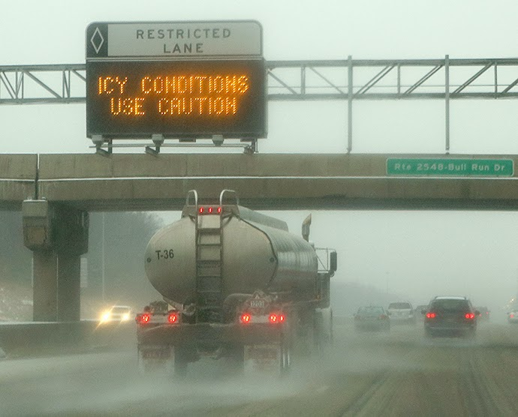
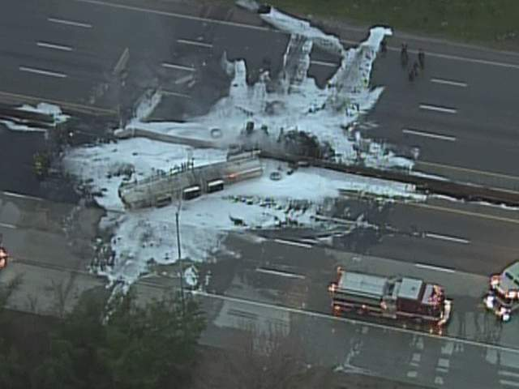
GIS-based Routing of Hazardous Material Cargoes Considering Incident Cost after Accidental Release of Chemicals
Bahareh Inanloo, Berrin Tansel and Xia Jin
Florida International University
Department of Civil and Environmental Engineering

Slide 2
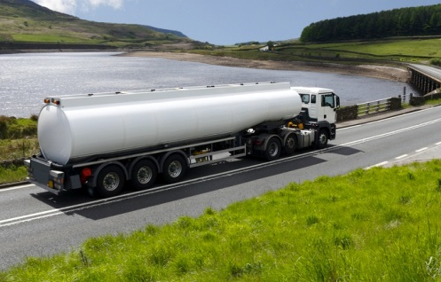
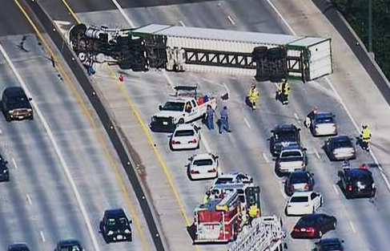
Hazardous Material Cargoes
More than 1 million hazardous material shipments are carried daily usually by trucks in the US.
Highway crashes involving hazardous materials have a societal cost of more than $1 billion a year.

Slide 3
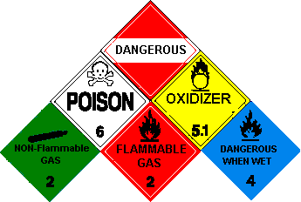
Hazardous Material Cargoes
Health impact assessment of an accidental release of gasoline compounds during transport.
Prediction of probable outcomes
Toxic vapor cloud
Routing the hazardous cargoes in order to decrease the adverse outcomes:
Health risk caused by toxic vapor cloud inhalation.
Delay cost caused by the accident.
Assumptions

Slide 4
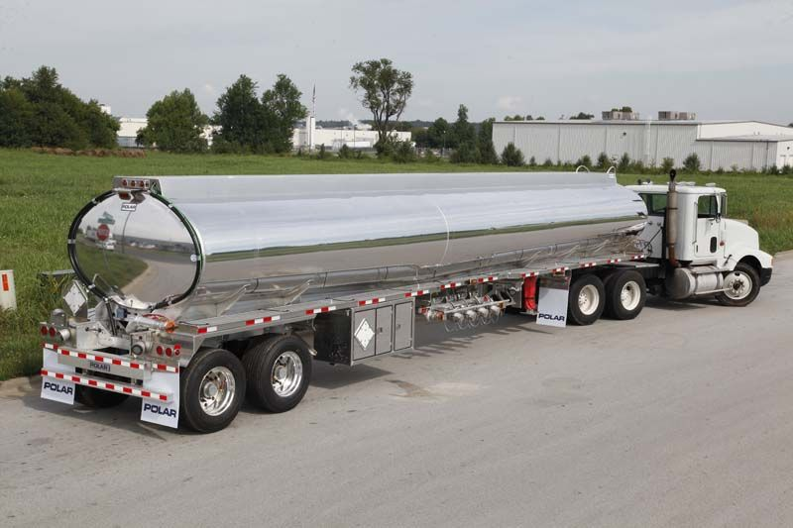
Hazardous Cargo Characteristics
Non Pressure Cargo Tank MC 306 / DOT 406
Oval cross section non-pressure
Single shell aluminum construction
9000 Gallon capacity
Transports E 10 blend of Gasoline with full capacity
Other assumptions:
Wind Speed (mph) | Wind direction | Temperature (F)
5 | SE | 55

Slide 5
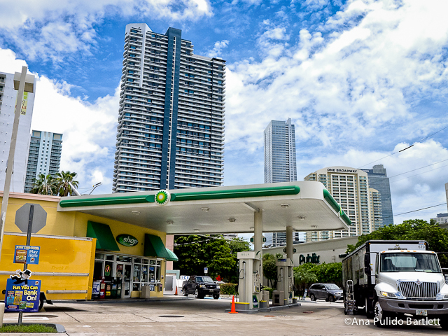
Origin and Destination of the Cargo
regtf
Origin
Origin: Port Everglades, Hollywood, FL, USA
Destination: A gas station, Downtown, Miami, FL, USA
Slide 5 of 18
Destination

Slide 6
Port Everglades
Supplies about one-fifth of Florida’s energy.
Every day:
About 12.5 million gallons of petroleum products is delivered.
About 400,000 individual gasoline fill-ups.
Provides petroleum products to gas stations in 12 counties all over South Florida.

Slide 7
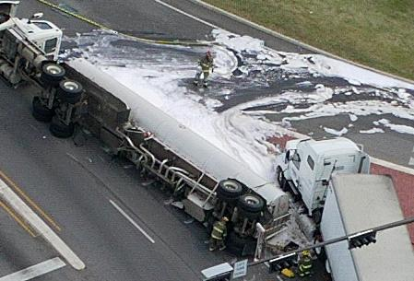
Methodology
Routing the hazardous cargoes:
Alternative routes identification
Health risk calculation
Delay cost calculation
Comparison of the routes

Slide 8
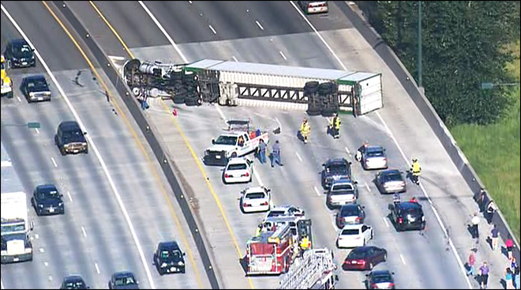
Risk Calculations
Risk according to DOT guideline:
$$Risk=(accident probability or frequency)×(accident consequences)$$
Data needed:
Accident probability or frequency
Accident consequences

Slide 9
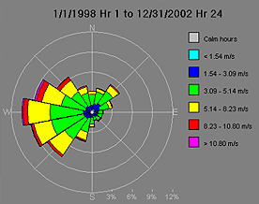
Accident Consequences, ALOHA
ALOHA (Areal Locations of Hazardous Atmospheres)
An air dispersion model able to predict airborne chemical concentrations.
Inputs:
Wind direction
Wind speed
Humidity
Date and time
Temperature
Location
Chemical characteristics

Slide 10
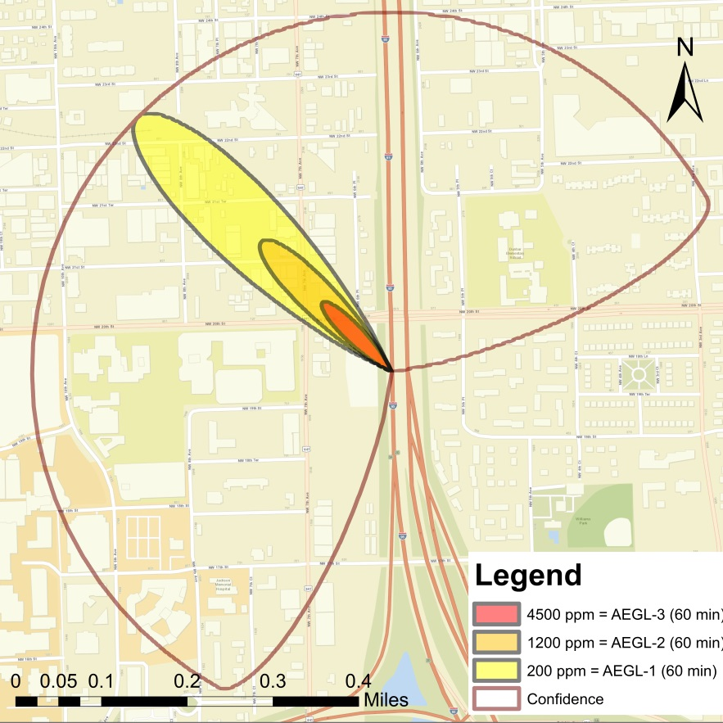
Accident Consequences, ALOHA
Abilities:
Sketches the impact radius
Has the ability to export the impact area to ArcMap and MARPLOT
Considers urbanization of surrounding area by assigning roughness
Outputs:
Visual expression of impacted zone

Slide 11
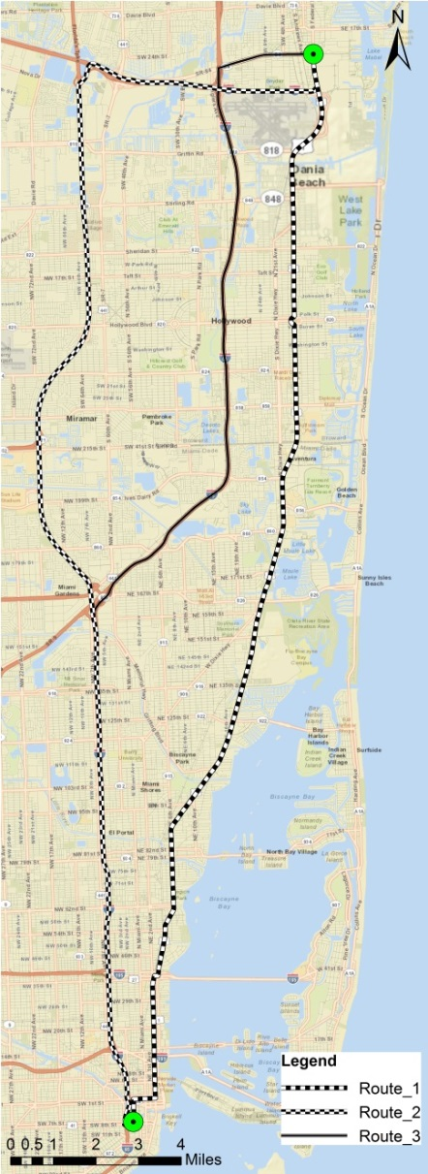
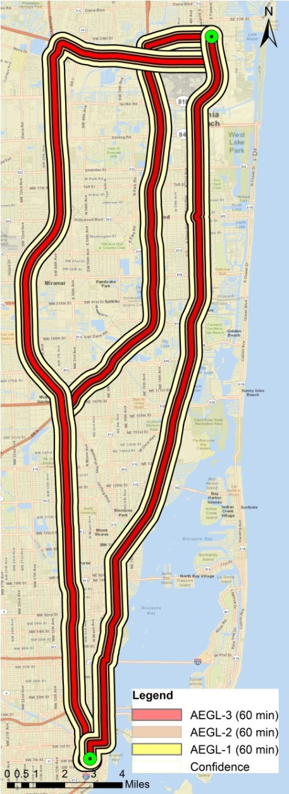
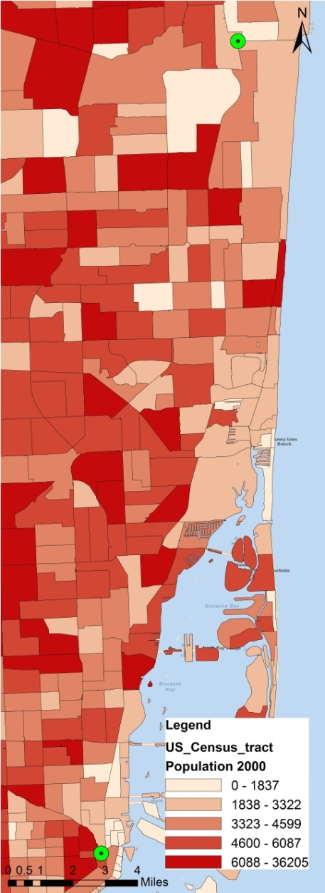
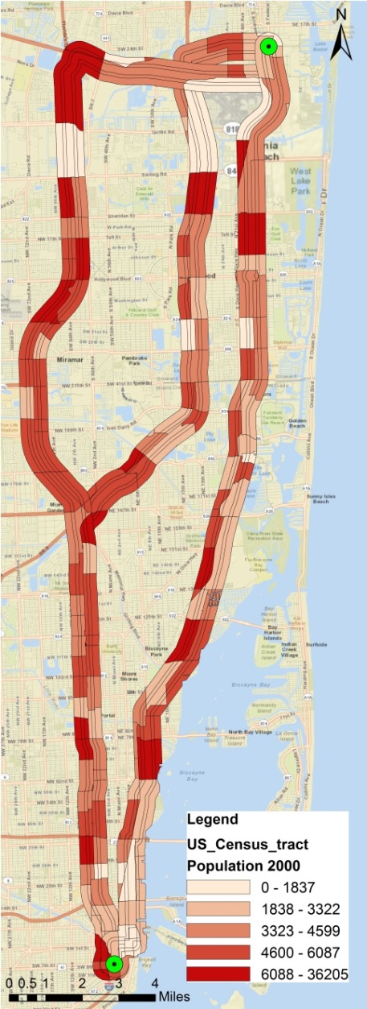
Health Impact Area Delineation
Slide 11 of 18
Impacted Population Identification
Health Impact Identification
Routes Overall Health Impact

Slide 12
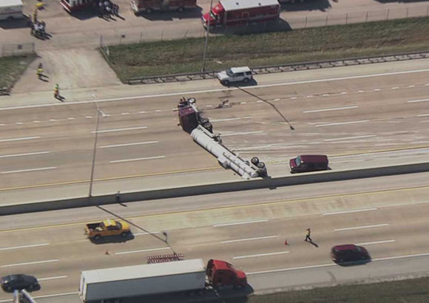
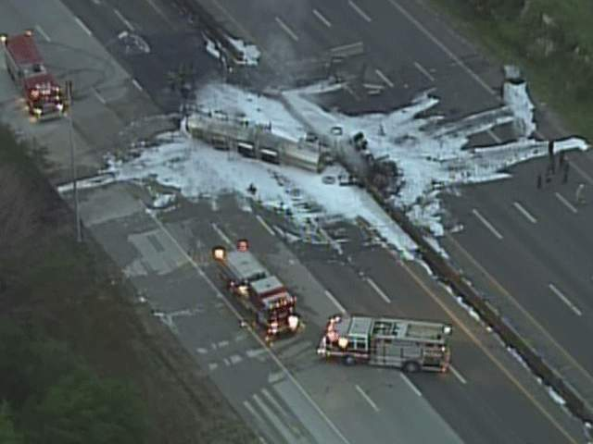
Risk Calculations, Accident Frequency
Accident probability or frequency:
Crash Rate:
$$R=\frac{C×100,000,000}{V×365×N×L}$$

Slide 13
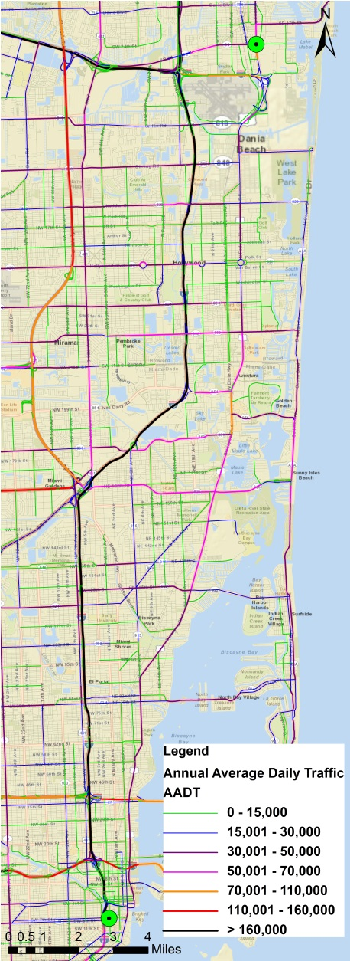
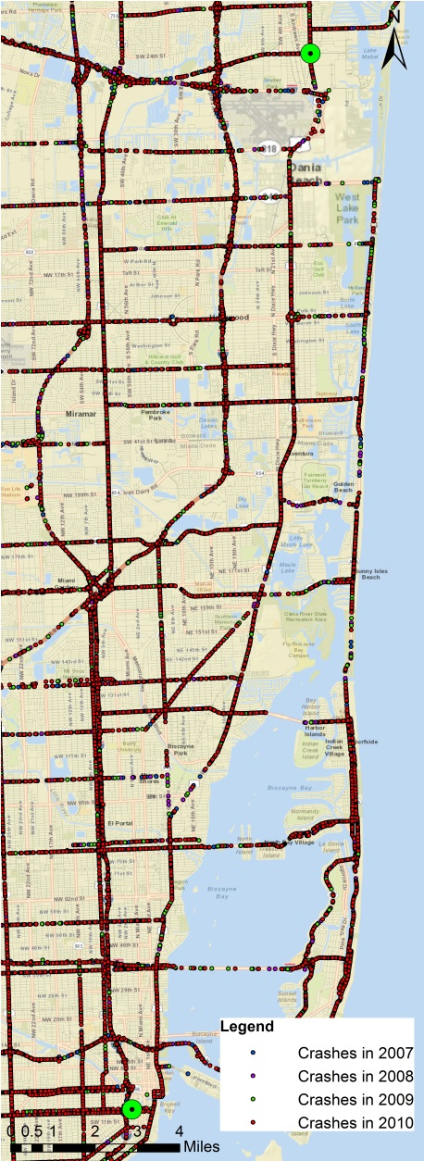
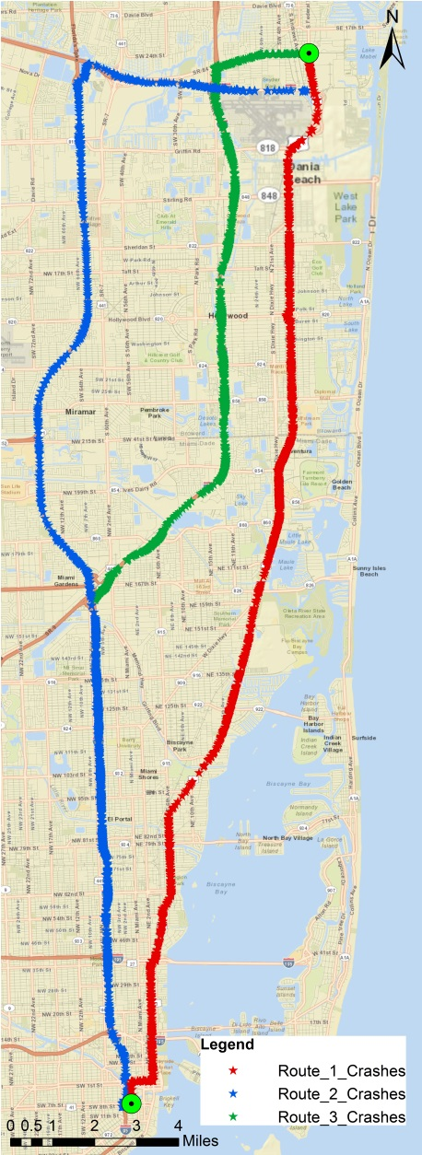
Crash Rate Calculations
Slide 13 of 18
Truck Routes
Crashes
Crashes Along the Routes
Annual Average Daily Traffic

Slide 14
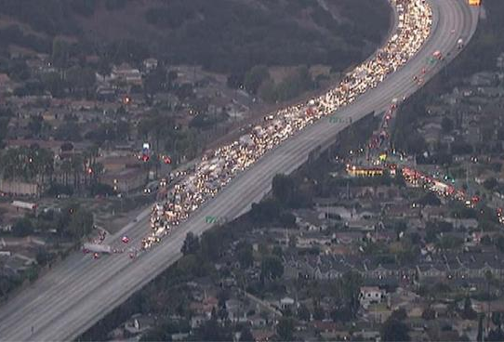
Delay Cost Calculations
Queuing analysis
Is used to calculate incident delays.
The total delay :
$TD=\frac{{t_{R}^{}}_{}^{2}(μ−μ_{R})×(AADT−μ_{R})}{2×(μ−AADT)}$
Data needed:
AADT
Road capacity
Capacity after accident

Slide 15
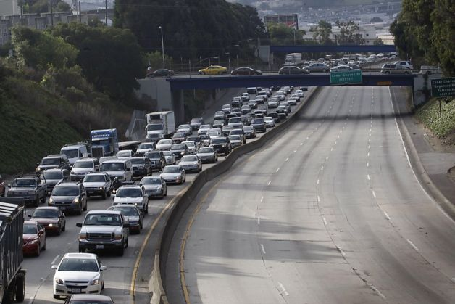
Delay Cost Calculations
Route Capacity Calculation
Remaining capacity
Free-Flow Speed (mph) | Base Capacity (pc/h/ln)
75 | 2,400
70 | 2,400
65 | 2,350
60 | 2,300
55 | 2,250
Number of Lanes | One Lane Blocked | Two Lanes Blocked | Three Lane Blocked
2 | 0.35 | 0.00 | N/A
3 | 0.49 | 0.17 | 0.00
4 | 0.58 | 0.25 | 0.13
5 | 0.65 | 0.40 | 0.20
6 | 0.71 | 0.50 | 0.26
7 | 0.75 | 0.57 | 0.63
8 | 0.78 | 0.63 | 0.41
2200

Slide 16
Route Comparison
Route_2
Route_3
Route_1

Slide 17
Concluding Points and Future Works
Prediction of health risk and delay cost.
Efficiently routing hazardous material cargoes.
Future works:
Using a Multi Criteria Decision Making method.
Scheduling the tanker trucks.
To provide a network of cargo routes.
Land use specification to avoid public places.

Slide 18
Thank you!
Questions?

