Slide 1
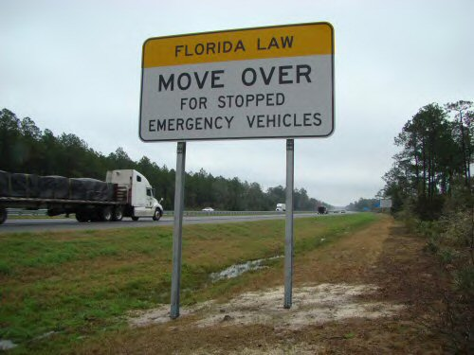
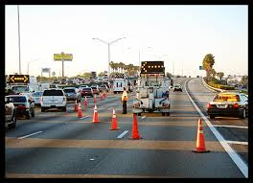
A Comprehensive Framework for Traffic Incident Management Program Planning and Assessment
Md Sakoat Hossan, Research Assistant
Xia Jin, PhD, Assistant Professor
UTC Conference for the Southeastern Region
Atlanta, Georgia
March 24, 2014

Slide 2
Scope of the Research
Develop a comprehensive framework for Traffic Incident Management (TIM) program that
Highlights the key components
Outlines the contributing elements
Serves as a basic guideline in program planning & assessment
Framework has been presented at last year’s UTC conference
Focuses on the applicability of the framework in program assessment using a case study based on FDOT District IV TIM program

Slide 3
Proposed Traffic Incident Management Framework
Traffic Incident Management Program
Strategic
Tactical
Support
Formal Program Establishment
Resource Management
Evaluation and Revision
Detection / Verification
Response /Scene Management
Traffic Management
Clearance and Recovery
Data / Information
Communications
Promotion
Plan Development
Gathering
Sustainability
Staff
Equipment
Performance Measures
Evaluation & Improvement Process
Documentation
Detection
Verification
On-Scene Tools
Management Teams
Diversion Plans
Signage and Control Systems
Safe, Quick Clearance Policy
Hazardous Material Clearance
Processing
Dissemination
Sharing
Tactical Communications
Media Communications
Traveler Information
Dispatch & Towing
Service Patrols
Major Incident Response Team
Finance
Strategic Communications

Slide 4
Characteristics of The Proposed Framework
Consistent
Consistent with the latest evolution
Applicability
Allows special techniques better suited for specific locals
Hierarchy
Follows the hierarchical structure
Comprehensive
Outlines all key components and elements with structured details
Usefulness
Useful at every stage of TIM program, from program initiation to program restructuring
Understandable
Intends to leverage an understandable framework

Slide 5
Strategic Preparation Joint Operation Policy (JOP)
Determine what policies agencies have in place regarding
fundamental Traffic Incident Management
Serves as the primary document for the following TIM components
Administrative Authorization
Contracts & Agreements
Strategic Missions & Goals
Coordinated Activities

Slide 6
Strategic Preparation Incident Response Manual (IRM)
Designed to provide uniform guidelines for incident
responders
Outlines the primary roles and responsibilities of the
various agencies
Serves as the primary document for the following TIM
components
Response Vehicle Parking Plan
Flashing Lights Policy
Safety
Incident Command System

Slide 7
Strategic Preparation Memorandum of Understandings (MOU)
Intended to provide the initial framework and guidelines
to promote a collaborative effort
Serves as the primary document for the following TIM
components
Organizational Structures
MOUs
Regular Meetings
Inter-Agency Agreements

Slide 8
Strategic Preparation Open Roads Policy
An MOU between Florida Highway Patrol (FHP) and
Florida Department of Transportation (FDOT)
All incidents need to be cleared from the roadway within
90 minutes of the arrival of the first responding officer
Both agencies will evaluate and continually update and
modify their operating policies, procedures, rules, and
standard
Each FDOT District will develop and implement response
procedures

Slide 9
Strategic Component Potential Areas for Improvement
Following improvement areas are identified through the
proposed TIM framework
Organizational Structure: Well-defined organizational structure
Resource Identification: Automated resource identification policy
Reimbursement Procedures: Separate finance section
Improvement Procedures: Task Force and Feedback Committee

Slide 10
Tactical Preparation Road Ranger
Provide free highway assistance services
One of the most effective TIM program of FDOT
Fully equipped to handle minor roadside emergencies
Assisted 129,805 customers in 2012

Slide 11
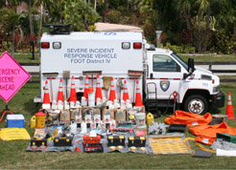
Tactical Preparation Severe Incident Response Vehicle (SIRV)
Provide an immediate response for severe incident
lasting longer than two hours
Acts like a FDOT correspondence, responds 24/7,
dispatched by TMC
Highly trained uniform incident management specialist
Carries necessary incident management equipment

Slide 12
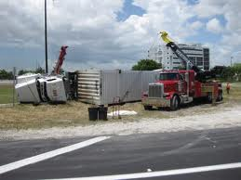
Tactical Preparation Rapid Incident Scene Clearance (RISC)
An incentive based heavy duty wrecker clearance program
Provides incentive for timely incident clearance
Payment is reduced for each minute over the time limit
A time suspension clause will exist for Hazardous
materials or extended clean-up

Slide 13
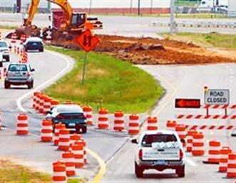
Tactical Preparation Maintenance Of Traffic (MOT)
A series of comprehensive online training video
Each responder should receive appropriate training
Followed Temporary Traffic Control (TTC) procedures
described in MOT
Designed to clearly define detour operations

Slide 14
Tactical Component Potential Areas for Improvement
Agencies exhibit better performance in tactical component
The following improvement area has been identified
through the proposed TIM framework
Secondary Incident Tracking: identifying criteria for secondary incidents
Oregon DOT – tracking criteria identification
Virginia DOT – dynamic queue-based identification tool

Slide 15
Support Preparation Inter-Agency Video Event Data Distribution System (IVEDDS)
IVEDDS is a web-based application that allows partner
agencies to access the roadway information
IVEDDS distributes live motion, closed circuit television
(CCTV) camera video feeds to partner agencies
Received FHWA award for Innovative Ideas
Helps the District to foster relationships with regional
public agencies

Slide 16
Support Component Potential Areas for Improvement
FDOT District IV have a robust ITS infrastructure,
which eventually helps TIM program
The following improvement area has been identified
through the proposed TIM framework
Data Integration & Processing Tools
Integrating data from different sources
Data Quality
Data Storage Capacity
Automated Data Processing

Slide 17
FHWA TIM Self Assessment
National TIM Program Assessment (2011)
Strategic | Tactical | Support
53.4 | 75.3 | 73.7
FDOT District Four TIM Program Assessment
Year | National | Broward | Palm Beach | Travel Cost
2012 | 68.2 | 89.6 | 80.6 | 73.3
2011 | 63.9 | 84.2 | 77.9 | 58.7
2010 | 60.0 | 81.4 | 60.1 | 38

Slide 18
Discussion
The proposed framework
Serves as an outline of all the key factors that are necessary for a successful TIM program
Provides structured details and elements that help achieving the goals of each program component
Could be useful at every stage of the TIM program – from development of a new program to evaluating any existing program or restructuring the program

Slide 19
Questions & Answers
Thank You
Md Sakoat Hossan
Department of Civil and Environmental Engineering
Florida International University
10555 W. Flagler Street, EC3725, Miami, Florida 33174
Tel: (786) 209-0375
Fax: (305) 348-2802
Email: mhoss009@fiu.edu
Xia Jin, Ph.D., AICP
Department of Civil and Environmental Engineering
Florida International University
10555 W. Flagler Street, EC3603, Miami, Florida 33174
Tel: (305) 348-2825
Fax: (305) 348-2802
Email: xjin1@fiu.edu

