Slide 1

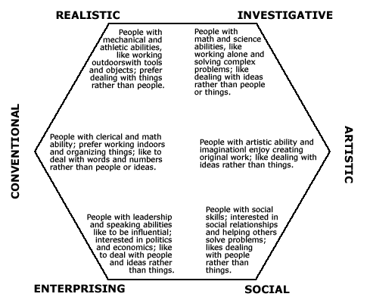
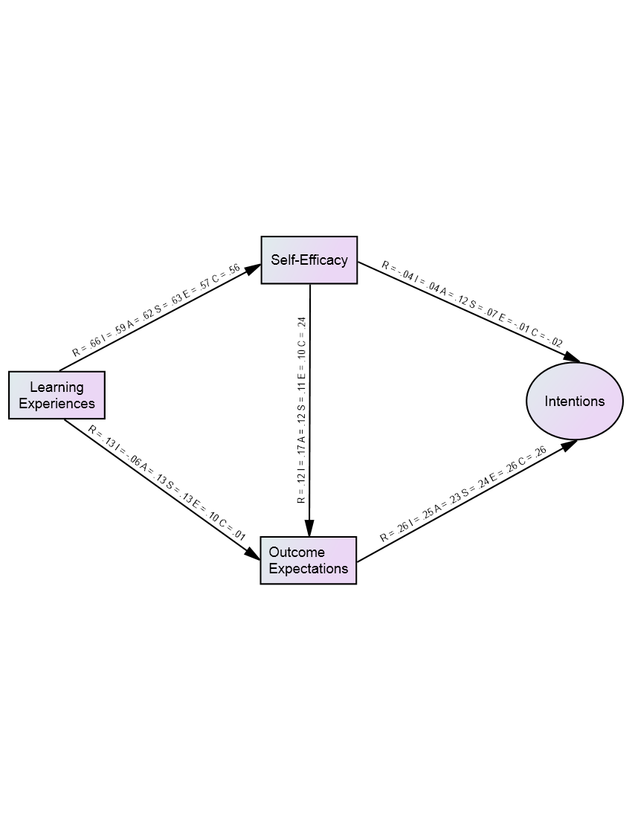
Predicting High School Students’ Transportation Career Intentions: A Social Cognitive Analysis
Patton O. Garriott, PhD, Stephanie Norris, BA, & Keaton Zucker, BA
University of Denver
Abstract
This study examined the utility of Holland’s (1997) career typology and social cognitive career theory (SCCT; Lent, Brown, & Hackett, 1994) in predicting the transportation career intentions of high school students (N = 156). Measures of learning experiences and self-efficacy for 6 Holland themes (Realistic, Investigative, Artistic, Social, Enterprising, Conventional) were modeled as predictors of transportation outcome expectations and career intentions. Results showed that each model, with the exception of the Conventional model, exhibited adequate fit to the data. Outcome expectations, but not self-efficacy, predicted transportation career intentions in each model.
Background
Transportation Recruitment Concerns: There are concerns regarding the transportation industry’s ability to fill vacancies in the transportation workforce over the next decade (United States Department of Transportation, 2012).
Role of Holland’s Typology: Conventional-themed career preferences have been found to predict transportation career intentions among college students (Philbrick & Sherry, 2004).
Social Cognitive Career Theory: SCCT has been found to predict career interests and goals across a variety of occupations (Sheu et al., 2010). Learning experiences are hypothesized to predict self-efficacy and outcome expectations which in turn predict intentions and goals (Lent et al., 1994; 2000).
Outcome Expectations: A key person-cognitive construct in SCCT, outcome expectations refer to one’s perception of possible outcomes that may arise from a given behavior. In a vocational context, they may be financial, interpersonal, and emotional.
Study Purpose: To examine the utility of Holland’s typology and SCCT in predicting the transportation career intentions of high school students.
Methodology and Design
Participants: After IRB approval, a sample of 156 high school students from the Rocky Mountain region of the U.S. completed a survey. 51.4% female (80), 48.6% male (76)
  57% Latina/o, 16% White/non-Latina/o, 8% Asian/Asian American, 6% African American, 4% biracial/multiracial, and 2% Native American
  33% Freshmen, 46% Sophomore, 10% Juniors, 8% Seniors
  Average age = 15.56 years
  All participants were enrolled in public high schools in the Rocky Mountain region of the U.S.
Measures: Participants completed a paper-and-pencil or online survey. The following instruments were administered in the survey:
  Learning Experiences Questionnaire (LEQ; Schaub & Tokar, 2004)
  Self-Efficacy Questionnaire (SEQ; Lenox & Subich, 1994)
  Outcome Expectations (Lopez & Lent, 1992)
  Transportation Career Intentions
    Fortune 500 companies (Philbrick & Sherry, 2004)
    Rating of how seriously would consider transportation career
    Rating of intention to pursue a transportation career
Data Analysis Plan: Structural equation modeling was used to examine fit of a hypothesized model informed by SCCT. Learning experiences predicted self-efficacy and outcome expectations. Self-efficacy and outcome expectations predicted intentions. The comparative fit index (CFI) and root mean square error of approximation (RMSEA) were used to assess model fit. CFI values ≥ .95 and RMSEA values ≤ .08 have been described as indicators of good model fit (Hu & Bentler, 1999).
Results:
SEM was used to test fit and examine relations among variables for six models corresponding to each theme of the Holland code. All models, with the exception of the Conventional model exhibited adequate fit to the data (CFI > .95; RMSEA < .08). Learning experiences predicted self-efficacy in each model, but not outcome expectations. Self-efficacy only predicted outcome expectations in the Conventional model. Outcome expectations predicted intentions in each model, but self-efficacy did not predict intentions.
Structural Model
Note. Values of .23 or greater are significant at the p < .001 level.
Discussion
Summary of Results
Hypotheses were partially supported in the present study.
While transportation career outcome expectations predicted transportation career intentions in each model, other social cognitive variables measuring Holland career typologies did not.
Unexpectedly, only the Conventional model did not exhibit adequate fit to the data, although Conventional self-efficacy did predict outcome expectations.
Implications
Outcome expectations are a robust predictor of transportation career intentions across Holland typologies.
Holland typologies may not be as useful a predictor of transportation career intentions among high school students.
Recruitment strategies that address possibly beneficial financial (earning an attractive salary), interpersonal (respect from others), and emotional outcomes (feeling good about oneself) of pursuing a transportation career may be useful with high school students.
Future Directions
Plan to collect additional data with high school students to increase overall sample size.
May develop instruments to assess learning experiences and self-efficacy specific to transportation careers.
May determine outcome expectations for more specific careers in transportation.
References
Holland, J. L. (1997). Making vocational choices: A theory of vocational personalities and work environments (3rd. ed.). Odessa, FL: Psychological Assessment Resources.
Hu, L. T., & Bentler, P. M. (1999). Cutoff criteria for fit indexes in covariance structure analysis: Conventional criteria versus new alternatives. Structural Equation Modeling: A Multidisciplinary Journal, 6, 1-55. doi: 10.1080/10705519909540118
Lenox, R. A., & Subich, L. M. (1994). The Relationship Between Self‐Efficacy Beliefs and Inventoried Vocational Interests. The Career Development Quarterly,42, 302-313.
Lent, R. W., Brown, S. D., & Hackett, G. (2000). Contextual supports and barriers to career choice: A social cognitive analysis. Journal of Counseling Psychology, 47, 36-49. doi:10.1037//0022-0167.47.1.36
Lent, R. W., Brown, S. D., & Hackett, G. (1994). Toward a unifying social cognitive theory of career and academic interest, choice, and performance. Journal of Vocational Behavior, 45, 79-122. doi:10.1006/jvbe.1994.1027
Lopez, F. G., & Lent, R. W. (1992). Sources of mathematics self‐efficacy in high school students. The Career Development Quarterly, 41, 3-12.
Philbrick, K. E., & Sherry, P. Perceptions of the Intermodal Transportation Industry Related to Recruitment and Retention of Human Resources. National Center for Intermodal Transportation. Mississippi, MS, 2004.
Schaub, M., & Tokar, D. M. (2005). The role of personality and learning experiences in social cognitive career theory. Journal of Vocational Behavior, 66, 304-325. doi:10.1016/j.jvb.2004.09.005
Sheu, H. B., Lent, R. W., Brown, S. D., Miller, M. J., Hennessy, K. D., & Duffy, R. D. (2010). Testing the choice model of social cognitive career theory across Holland themes: A meta-analytic path analysis. Journal of Vocational Behavior,76, 252-264.
United States Department of Transportation (2012). Research and Innovative Technology Administration: National Transportation Workforce Development. http://www.rita.dot.gov/ntwd/next/index.html#recruit. Accessed January 6, 2014.
Please address correspondence to: Patton O. Garriott, Department of School and Counseling Psychology, University of Denver,1999 E. Evans Ave., 201A Ruffatto Hall, Denver, CO 80208. Email: Pat.Garriott@du.edu.

