Slide 1
Queue Length Estimation Based on Point Traffic Detector Data and Automatic Vehicle Identification Data
24, March 2014

Slide 2

Contents
Detector Data
AVI data
Methods
Case Study 1
Case Study 2

Slide 3
FIU/UCF Joint Project
Joint project between FIU and UCF
  Mohammed Hadi, Ph.D., P.E. (PI)
  Haitham Al-Deek, Ph.D., P.E. (UCF PI)
  Omer Tatari, Ph.D (Co-PI)
  Yan Xiao (Co-PI)
  Somaye Fakharian (FIU Ph.D. student)
  Frank A. Consoli, P.E. (UCF Ph.D. Student)
  John Rogers, P.E. (UCF Ph.D. Student)

Slide 4

Progress Diagram
.
Phase 1
Phase 2
Phase 3
SR 826(0.947, Detectors,0311 mile
Simulation (CORSIM)
Real world
Comparison of simulation and real world
Turnpike , 1.8 Mile
4 detectors
All methods
Real World Data
Estimation of Density

Slide 5

Detector Data
Speed Based
Base on speed, the link is
1: Fully congested, if the speed based on both detectors< 40 M/Hr
2: Uncongested: if the speed based on both detectors >= 40
3: Partially Congested: If the speed based on one detector < 40
Volume Based
  Arrival vehicle > Departure Vehicle

Slide 6
AVI Data
Speed Based
1: Average Speed for the segment < 40 is totally congested
2: Average Speed>= 40 is totally Uncongested

Slide 7
Combination of Detector and AVI Data
Speed Based
1: For fully congested(based on Detector), average speed based on AVI
2: For totally uncongested (based on Detector): average speed based on AVI
3: Partially Congested: base on relationship sped and travel time, the partial queue is estimated.

Slide 8
Combination of Detector and AVI Data
Travel Time Based
1: For fully congested(based on AVI), average travel time is calculated
2: For totally uncongested (based on AVI): average travel time is calculated
3: Partially Congested: the linear regression for each travel time between fully congested and fully uncongested.

Slide 9
Methods For Queue Length Estimation
AVI (Average Speed)
Detector (Average Speed and Volume)
Queue Length Estimation
Combination of AVI and Detector(Travel Time and Speed)

Slide 10
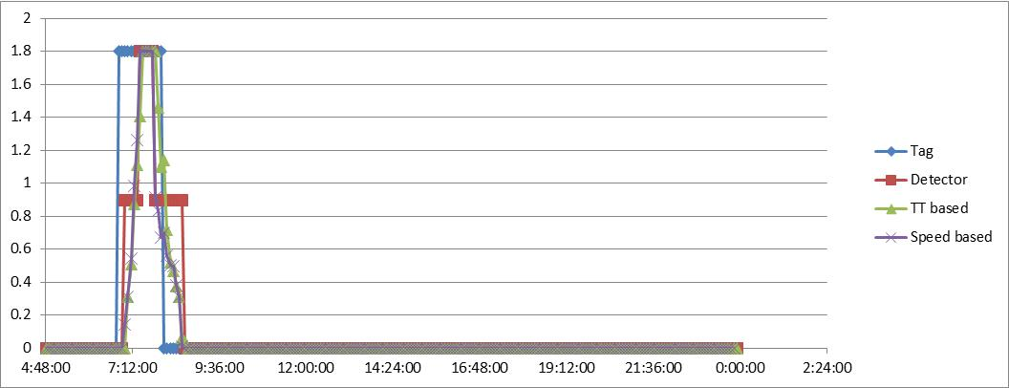
Case Study 1: (Turnpike)

Slide 11
Table (Turnpike)

Slide 12
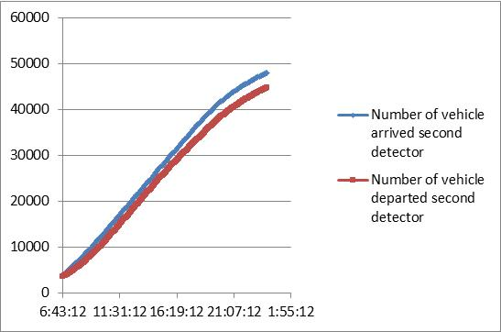
Diagram (Cumulative Volume)

Slide 13
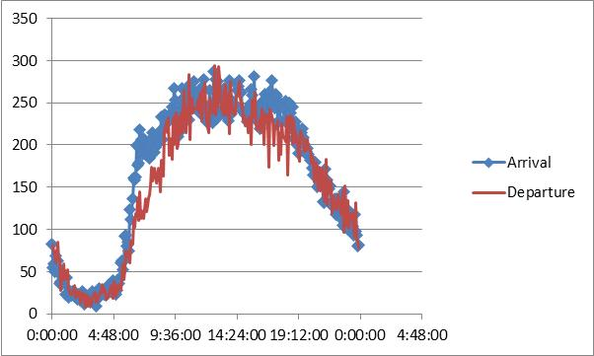
Diagram (Volume)

Slide 14
Case Study 2: (SR 826- Simulation CORSIM)
Based on simulation
Sensitivity multiplier by 200%
Two link are congested
Link 1: o.48 mile
Link 2: 0.46
Detector 1: 0.387 mile from upstream
Detector 2: 0.23

Slide 15
Case Study 2: (SR 826- Simulation CORSIM)

Slide 16
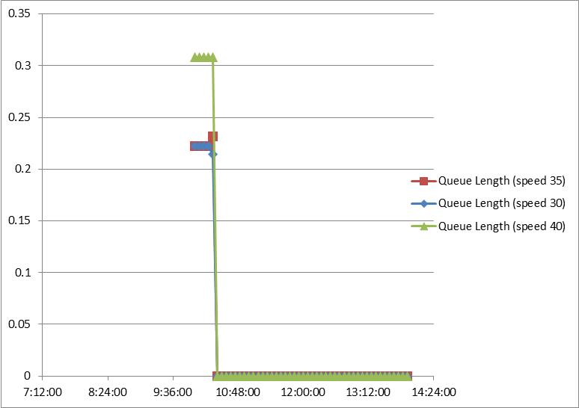
Case Study 2: (SR 826- Simulation CORSIM)

Slide 17
Case Study 2: (SR 826- Real world
Based on detector data
Based on AVI data, matching each individual vehicle from link 1 to link 2
All methods are used for Turnpike(Detector, AVI, Combination of detector and AVI)
Cumulative volume (Based on detector data)

Slide 18
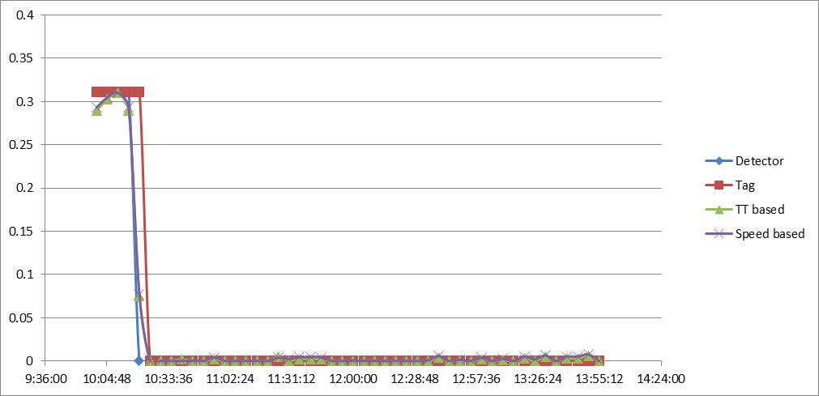
Case Study 2: (SR 826- Real World)

Slide 19
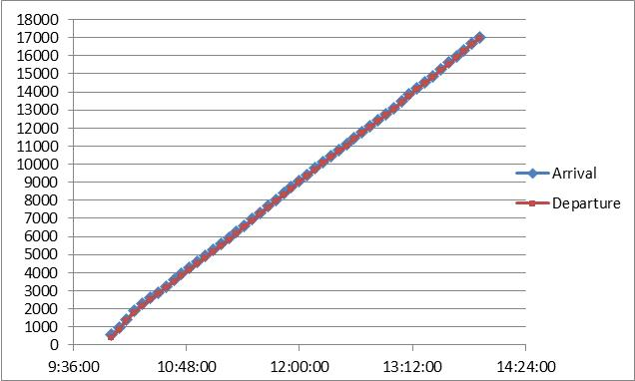
Diagram (Cumulative Volume)

Slide 20
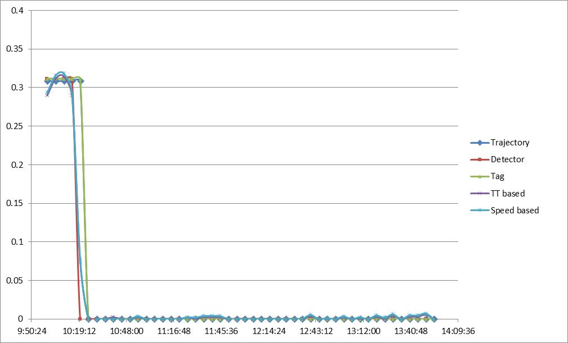
Case Study 2: (SR 826- Comparison of Simulation and Real World)

Slide 21
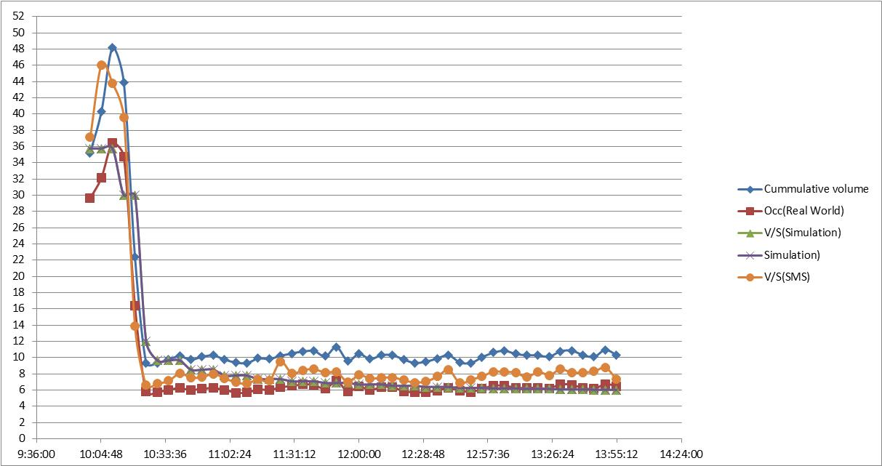
Density Estimation

Slide 22

Question?
AVI
Detector
Combination

Slide 23
Thank You !

