Slide 1
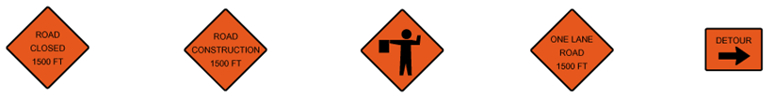
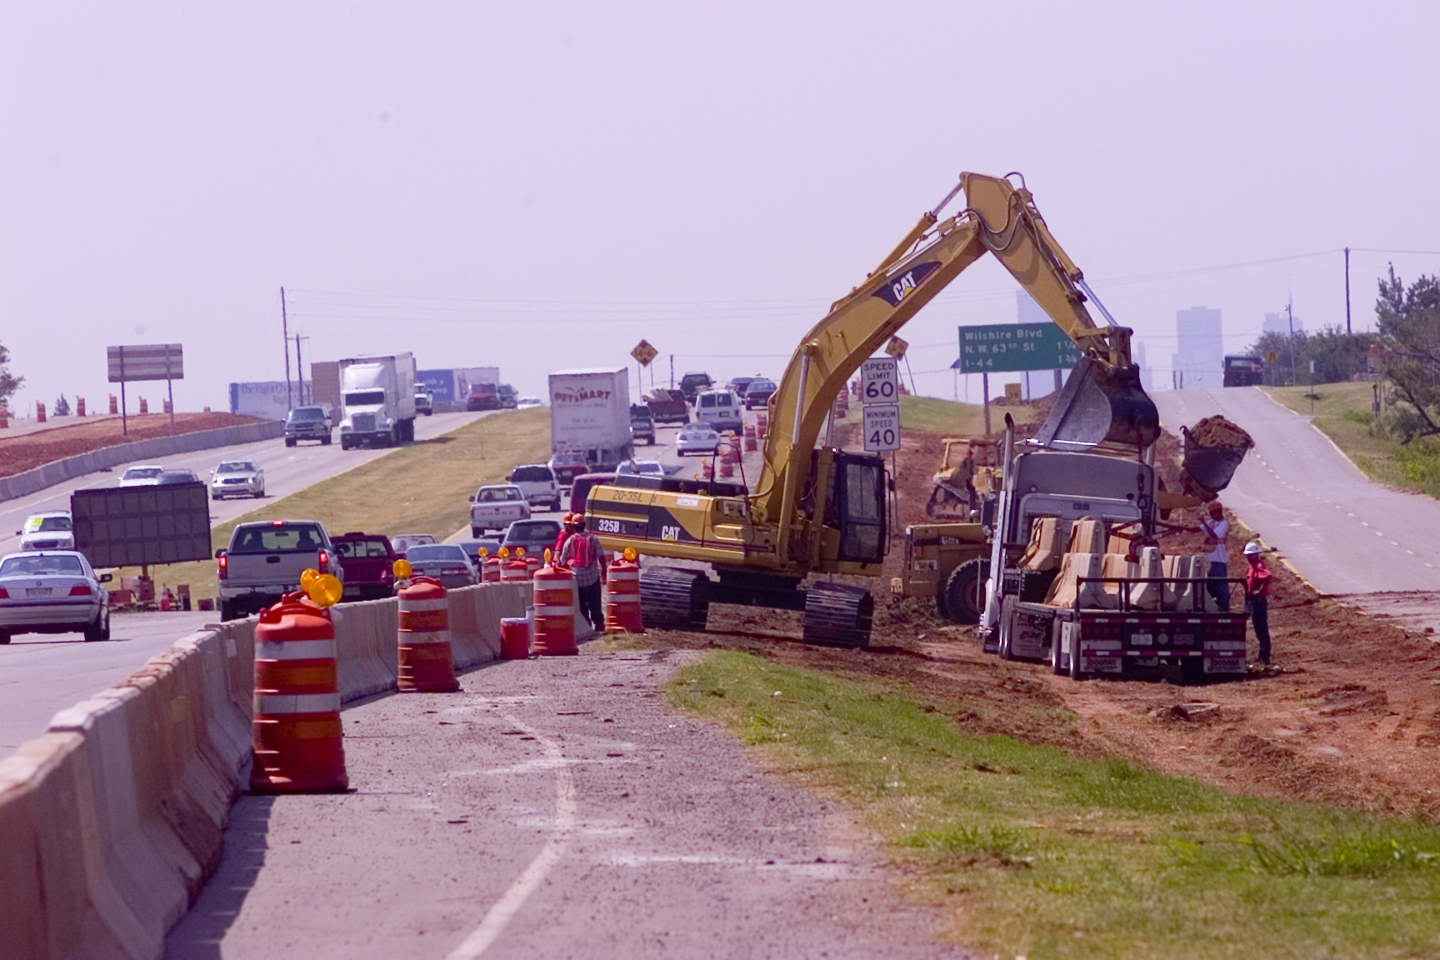


Operational Evaluation of Dynamic Lane Merging In Work Zones With Variable Speed Limits
Dr. Essam Radwan, P.E.
Mr. Zaier Zaidi
Dr. Rami Harb, P.E.
Road Safety on Four Continents (RS4C) Conference
Beijing May 15-17, 2013
University of Central Florida

Slide 2
Presentation Outline
Introduction
Work Zone Management Schemes
Operational Concerns in Work Zones
Simplified Dynamic Lane Merge System
Variable Speed Limit (VSL) Systems
Simulation of SDLMS and VSL Sensors
Analysis of Simulation Runs
Conclusions
University of Central Florida

Slide 3
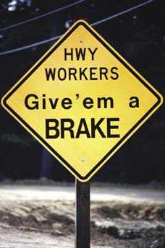
Work Zone Challenges
Accidents in construction areas: 30% involves workers and 70% involves motorists
Motorists suffer approximately 700 fatalities, 40,000 injuries, and 52,000 property-damage-only accidents, at a total cost of $6.2 billion per year
University of Central Florida

Slide 4
SDLM Project
Project sponsored by FDOT
Objective: To explore a Simplified Dynamic Lane Merge System for short term work zone activities using ITS technologies
Test the concept at 2 sites in FL
University of Central Florida

Slide 5
MAS
Motorist Awareness System (MAS)
Implemented in FL Work Zone where ITS is not available.
If workers are present reduce speed limit by 10mph (not less than 55mph)
Taper distance based on speed limit not reduced speed
Work activity, equipment, workers are restricted to one side of the roadway
When work is not taking place all equipment shall be removed
University of Central Florida

Slide 6
Work Zone Management Schemes
LANE MERGING SCHEMES
Static Early Merging: No real time change / additional “LANES CLOSED” sings (McCoy and Pesti, 2001; Beacher et al., 2001; Beacher et al., 2004)
Dynamic Early Merging: Real time change/ Flashing signs (Tarko, 1998; McCoy et al., 1999; Tarko and Venugopal, 2001; Wayne State University, 2001)
Static Late Merging: Static Signs “USE BOTH LANES TO MERGE POINT” (McCoy et al., 1999; Walters et al., 2001; Byrd, 1999; Walters et al., 2001)
Dynamic Late Merging: Dynamic Signs “USE BOTH LANES TO MERGE POINT” (McCoy and Pesti, 2001; Beacher et al., 2004; Bushman et al., 2004).
University of Central Florida

Slide 7
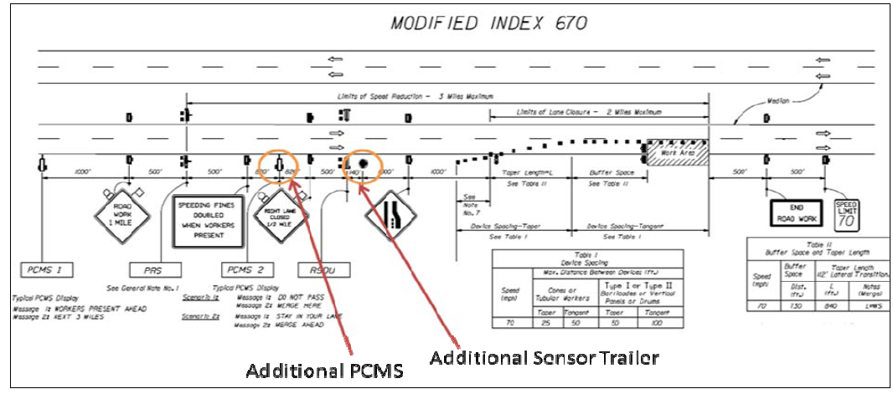
SDLMS System Design
University of Central Florida
Notes:
7

Slide 8
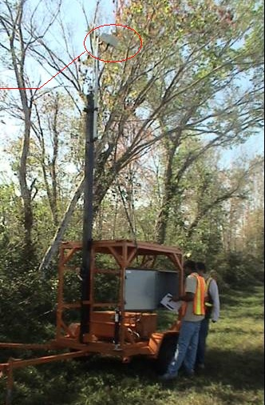
DLM System Design DLM Components
RTMS : Remote Traffic Microwave Sensors
On-board processor
UHF communication modem
Central communications system
PCMS : Portable Changeable Message Sign
RTMS Unit
University of Central Florida

Slide 9
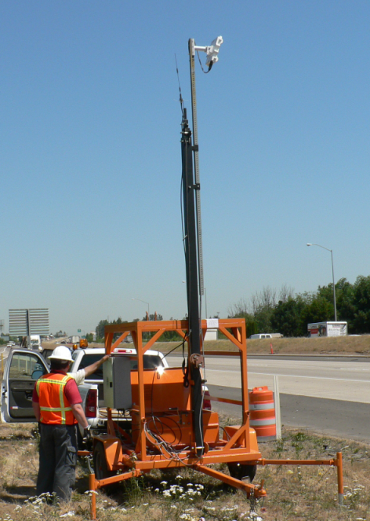
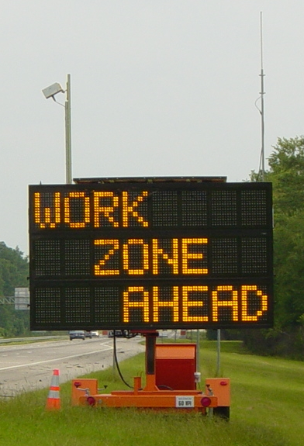
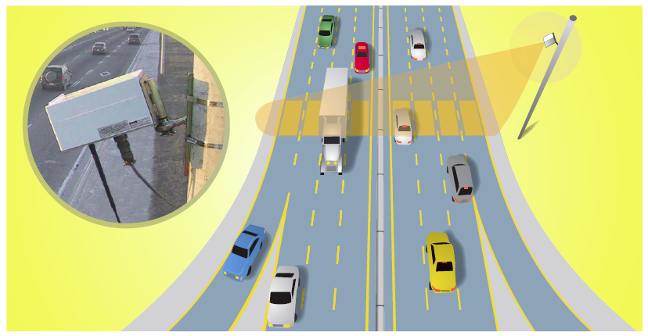
DLM System Design DLM Components
University of Central Florida

Slide 10
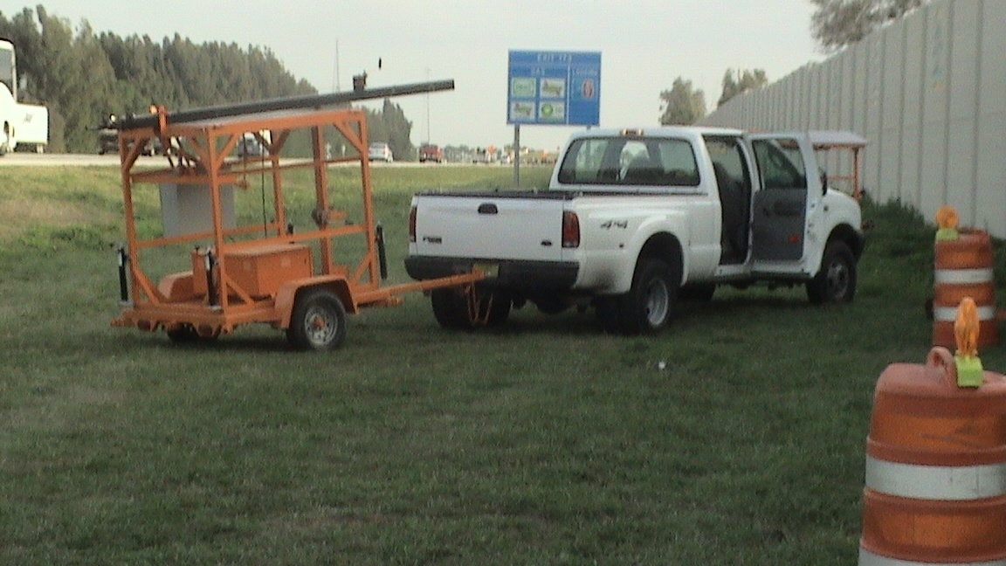
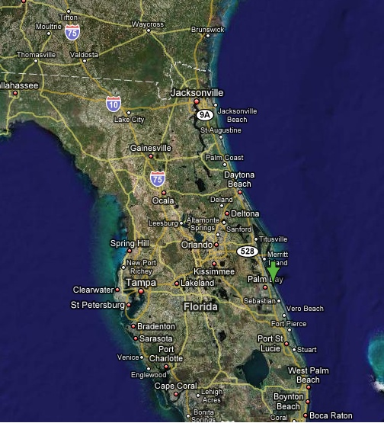
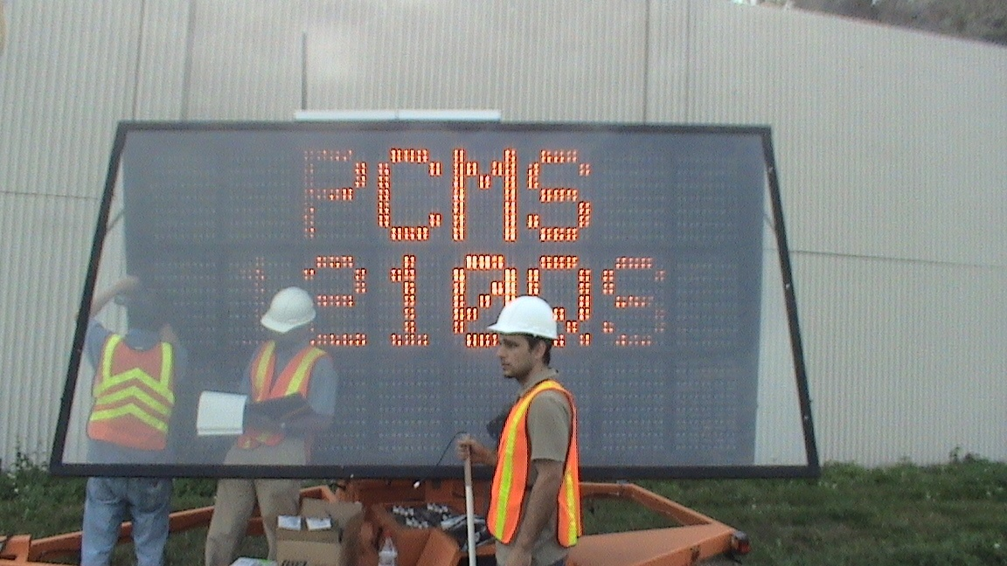
DLM System Design DLM SETUP
University of Central Florida

Slide 11
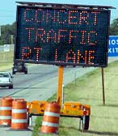
DLM System Design DLM MESSAGES
MAS: Flashing CAUTION/CAUTION
Early Merge: DO NOT PASS/ MERGE HERE
Late Merge: MERGE AHEAD/USE BOTH LANES
Minimum activation time Shall not be less than 5 min.
University of Central Florida

Slide 12
VSL System
: Integrated DLM/VSL System (Source: Kang et al., 2006)
University of Central Florida
Notes:
12

Slide 13
Modified MAS with VSL and SDLMS
Traffic Sensors for VSL
VSL replacing PRS
University of Central Florida
Notes:
13

Slide 14
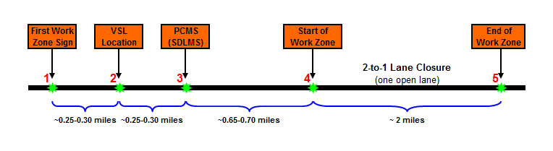
VSL System
Modified MOT Plan (with VSL) Replication in VISSIM
University of Central Florida
Notes:
14

Slide 15
VAP Logic for DLMS+VSL
Notes:
15

Slide 16
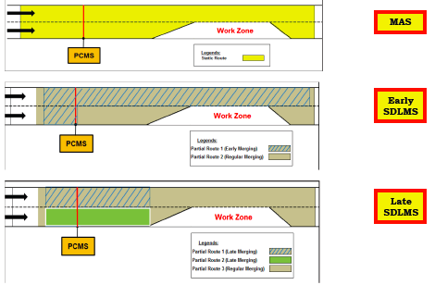
VISSIM Coding of SDLMS
Notes:
16

Slide 17
Scanrios Tested in VISSIM
Safety evaluation of all six MOT types tested through the VISSIM model is,
Work Zone without VSL and without SDLMS
Work Zone with VSL and without SDLMS
Work Zone with VSL and Early SDLMS
Work Zone with VSL and Late SDLMS
Work Zone with early SDLMS and without VSL
Work Zone with late SDLMS and without VSL
Notes:
17

Slide 18
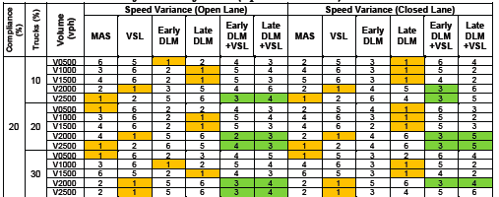
Results
Notes:
18

Slide 19

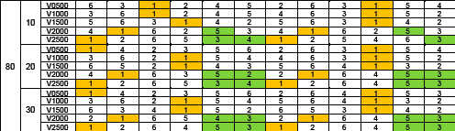
Results
Notes:
19

Slide 20
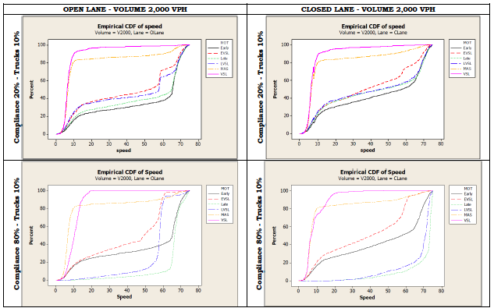
Results
Notes:
20

Slide 21
Major Findings
In terms of speed variances, generally, early and late SDLMS performed better in both open and closed lane than all other MOT types for low and medium volume levels (V0500, V1000 and V1500).
For demand volumes of V2000 and V2500, VSL and MAS were significantly better than SDLMS combinations, respectively.
It was a noteworthy finding that no matter early and late SDLMS performed poorly as compared to VSL and MAS when higher volumes were involved, but the addition of VSL improved their safety aspect by decreasing the speed variance of the vehicles travelling in both open and a closed lane.
Notes:
21

Slide 22
Major Findings
The speed variance reduction may indirectly contribute to improving the overall traffic safety in work zones.
The addition of VSL to the dynamic merge systems helped in lowering speed variances of the vehicles travelling in the work zone.
The passage of traffic through the work zone is made safer when a speed control is integrated to dynamic merge system.
Notes:
22

Slide 23
Thank You!
Questions?
University of Central Florida

