Slide 1
Economic Development and Workforce Impacts of GDOT Highway Expenditures
(Interim Report Submitted to UTC: 5/8/13)
PI Prof. T D. Boston & R. Uwaifo
School of Economics Ga. Tech

Slide 2
Purpose of UTC Research
Measure the impact of GDOT’s highway expenditures on statewide economic activity, income, employment, tax revenues and workforce development, FY 2009 – 2011
Specify geographic location of impacts ( i.e. by county and Highway District and special impacted areas)
Overlay impacts on Environmental Justice and underserved areas.
Measure employment opportunities created by GDOT contractors, including diverse vendors such as small businesses, women-owned businesses, DBEs and businesses owned by minorities and disadvantaged groups.
Outline method for replicating approach nationally and disseminate results

Slide 3
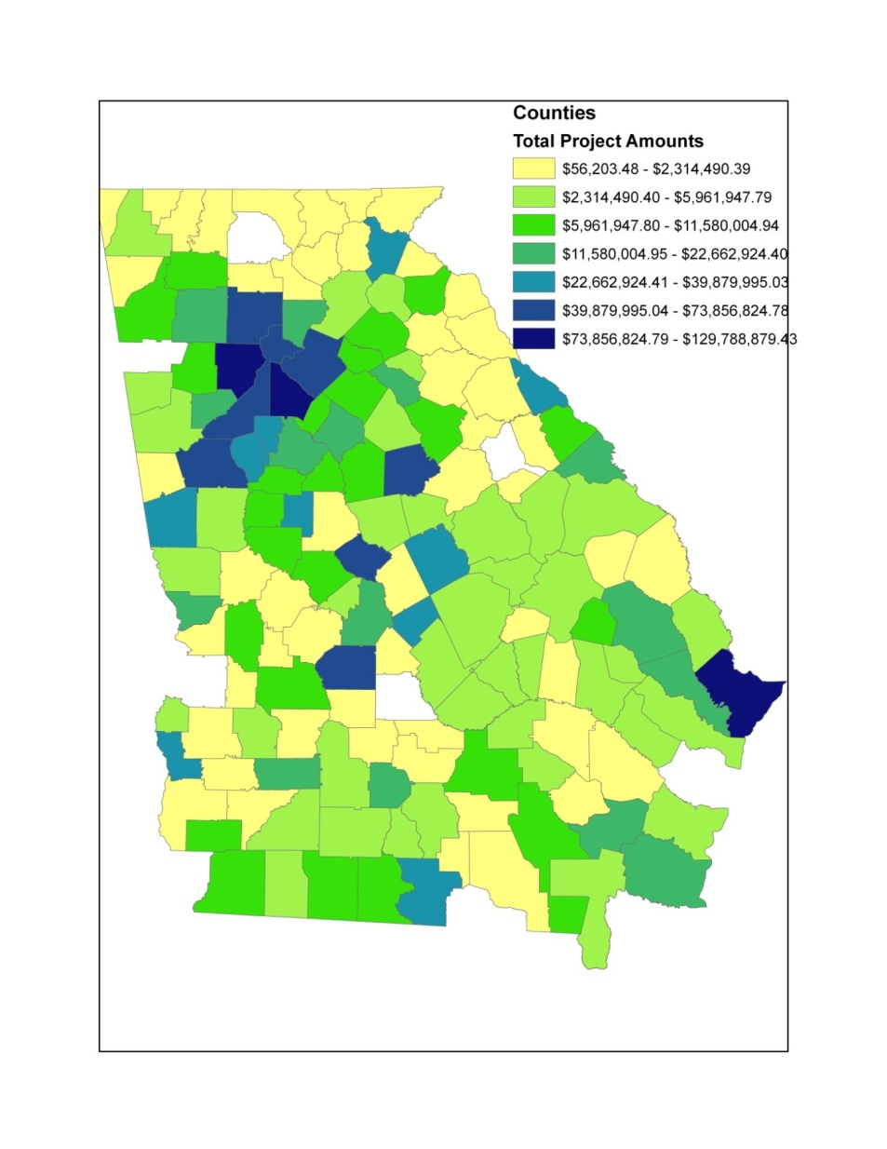
GDOT Highway Expenditures by County FY 2009 - 2011
The economic Impact analysis will start by geographically classifying all GDOT’s expenditures. Next it will apply a statewide input-output model to determine for each location the total economic activity ( i.e. final demand created, jobs generated, household income, and county and state tax revenue.
Impacts will be broken down further by vendor category: prime contractors, subcontractors, DBEs, women-owned businesses and businesses that could be certified as small –using the new small business program criteria.
Notes:
’10 most powerful women entrepreneurs’ by Fortune, "In China, no matter what industry you're in, you can try something new and put all your thoughts into doing so, because nothing was previously there. It still feels like anything is possible."

Slide 4
Research Steps #1 – Establish Profile of Highway Projects and Awardees
Document the number, value and geographic location of projects and awards: FY 2009 - 2011
  Geocode location of projects
  Geocode addresses of awardees
Identify awardees by relevant criteria:
  Prime contractors
  Subcontractors
  Small businesses
  Disadvantaged Business Enterprises (DBEs)
  Race and gender ownership characteristics

Slide 5
Steps #2: Profile GDOT Contractors and Vendors
Document GDOT Vendors and Contractors
  Prequalified prime contractors
  Registered subcontractors
  Prequalified professional consultants
  Potentially certifiable small businesses
  Disadvantaged Business Enterprises (UCP)
Document Revenue and Employment Characteristics of Vendors
  Total Revenue
  Total Employment
  Industry (GDOT work code and NAICS)

Slide 6
Steps #3: Link Highway Projects to Vendor Profile
Merge GDOT Highway Award Data with Vendor Characteristics Data
  NAICS
  Geographic location
  Prime contracts
  Subcontracts
  Small business
  DBEs
  Gender status

Slide 7
Steps #4: Measure Impacts
Acquire Statewide Input-Output Model
Measure Statewide Impacts
  Total Final Demand, Household Income, jobs created, County Tax Revenue, State Tax Revenue
Breakdown Impacts by Geographic Area
  County, GDOT District, Special Area Impacts
Breakdown Impacts by Sub-groups
  DBEs, Women-owned businesses, Small Businesses

Slide 8
Steps #5: Prepare Draft Final Report
PROPOSED OUTLINE OF FINAL DRAFT
Executive Summary of Findings
Impact Analysis; FHWA and Government Policy Mandate
Literature Review and Background
Potential Benefits of Impact Analyses
Detailed Findings: Total Final Demand, Household Income, jobs created, County and State Tax Revenue
Breakdown of Impacts by Geographic Area: County, GDOT District, Special Area Impacts
Breakdown of Impacts Sub-groups: DBEs, Women-owned businesses, Small Businesses
Lessons Learned, Transferability of Technology and Models
Dissemination of Results

Slide 9
Project Funding and Expenditure Status
Project Date: Start May 1, 2012, End August 31, 2013
Total Months = 16 mos.
Time Expended to Date: 75% time
Total Project Authorized Expenditures = $213,409
  Funds Authorized by GDOT = $125,000
  Funds Authorized by UTC = $88,409
Expended as of 4th Quarter (getting current update thru 1st Qt. 2013)
  Funds Expended GDOT ; $43,848 = 35.07%
  Funds Expended UTC ; $87,765 = 99.27%
  % of Total Project Funds Expended = 61.67%

Slide 10
Work Plan Accomplishments

Slide 11
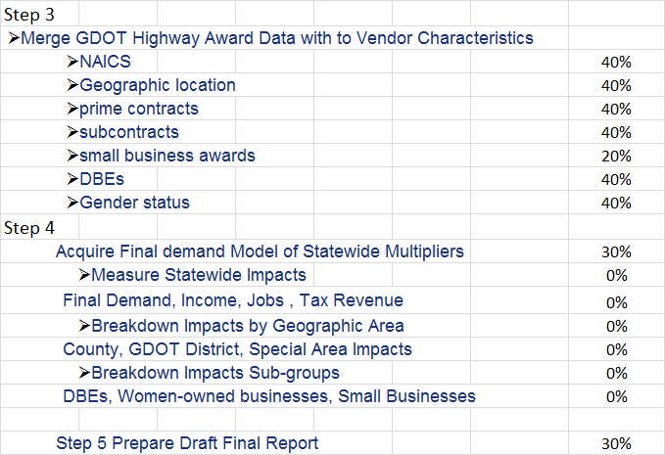
Work Plan Accomplishments

